Slide 1
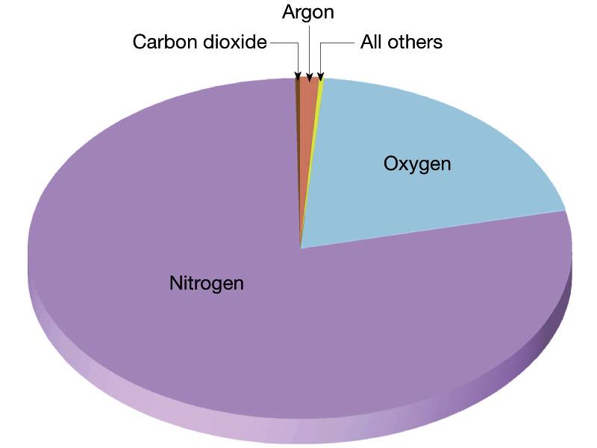
Composition of the Earth Atmosphere

Slide 2
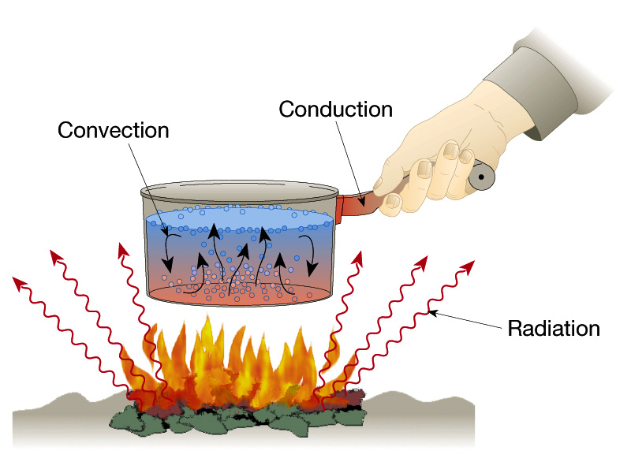
Mechanisms of heat transfer
(Oceans/Atmosphere)
(Geothermal)
(Solar)

Slide 3
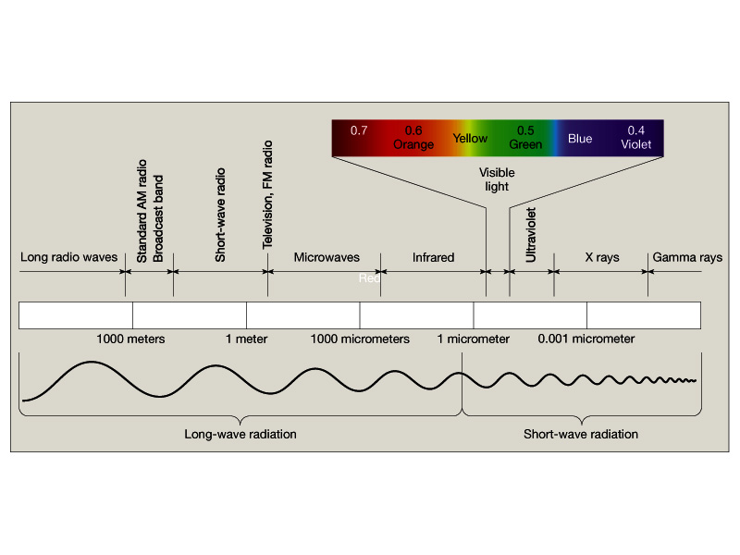
Electromagnetic Spectrum

Slide 4
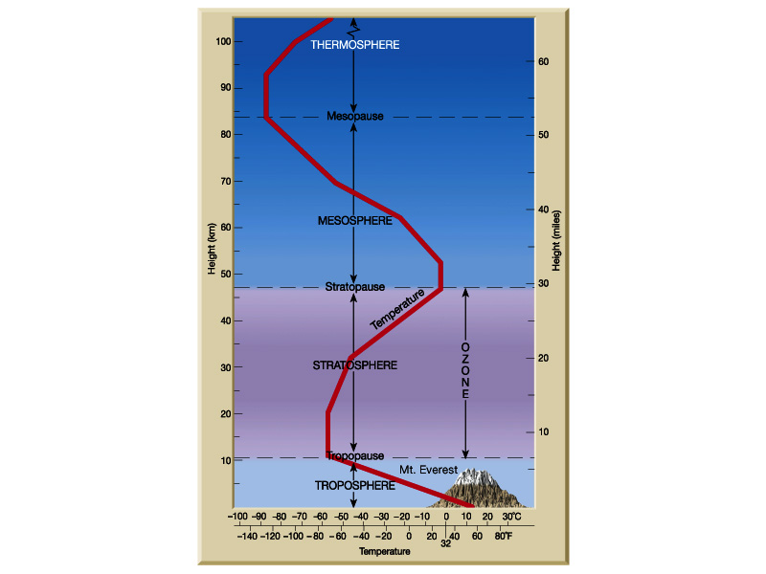
Structure of the
Earth atmosphere

Slide 5
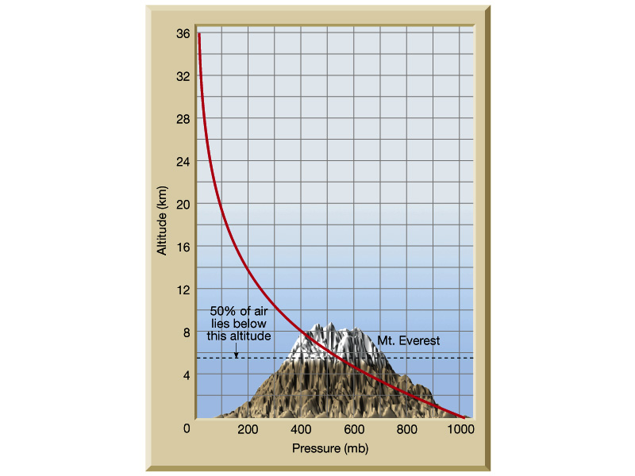
Pressure-altitude relationships
in troposphere

Slide 7
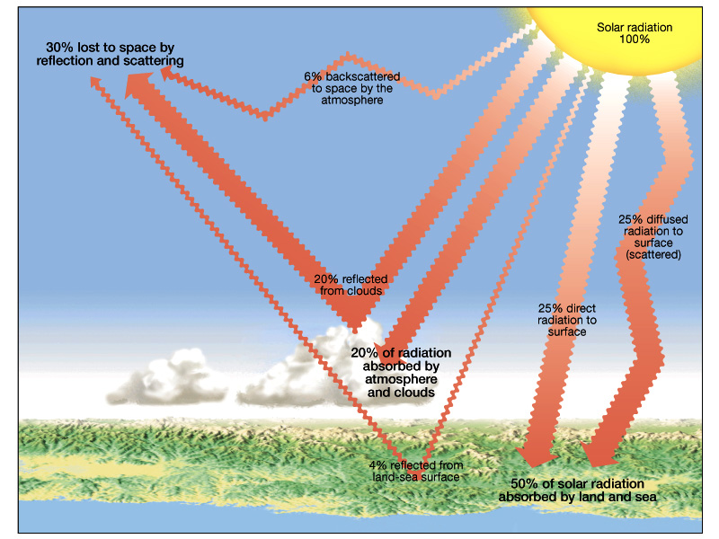
Earth solar energy budget

Slide 8
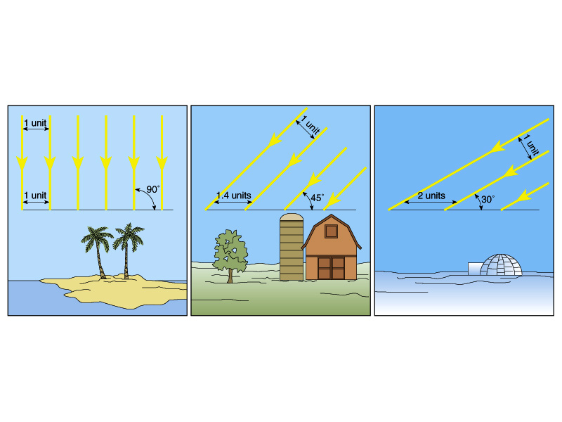
Low Latitude-----------------------------------------High Latitude
Latitudinal heating effects as related to solar ray angle of
incidence

Slide 9
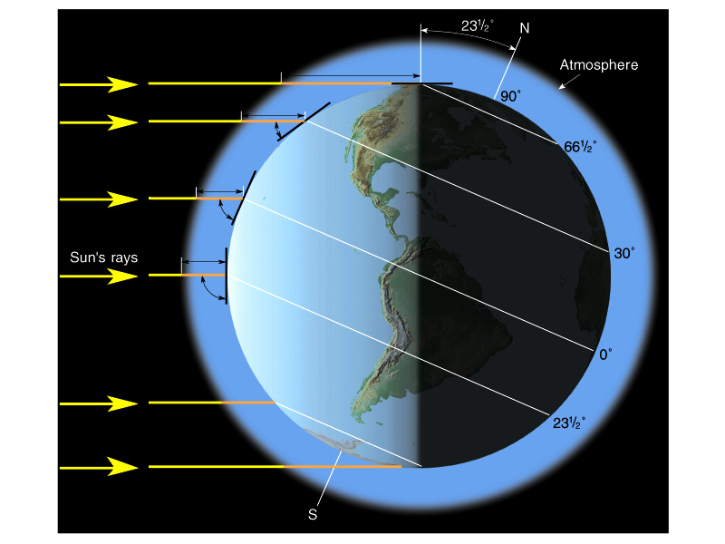

Slide 10
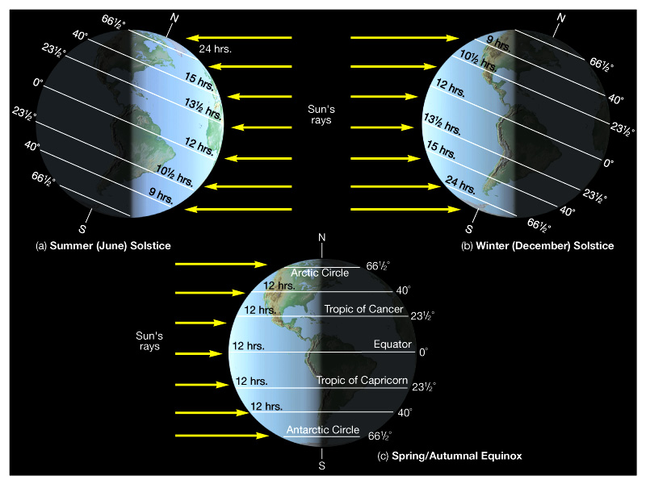

Slide 11
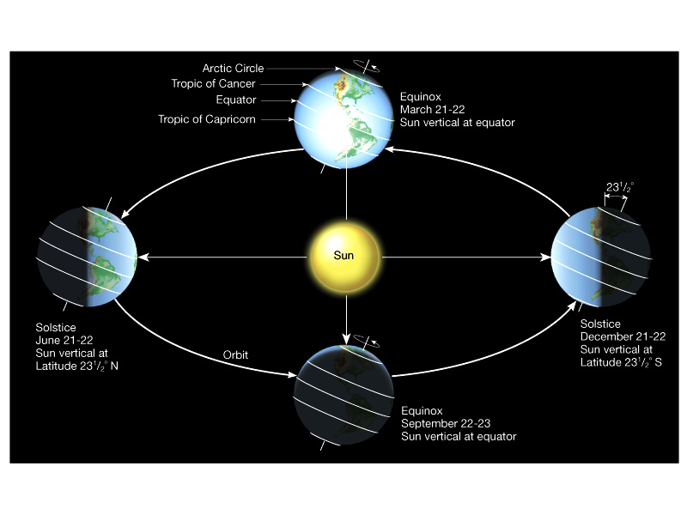
Seasonal heating and cooling of Earth atmosphere

Slide 12
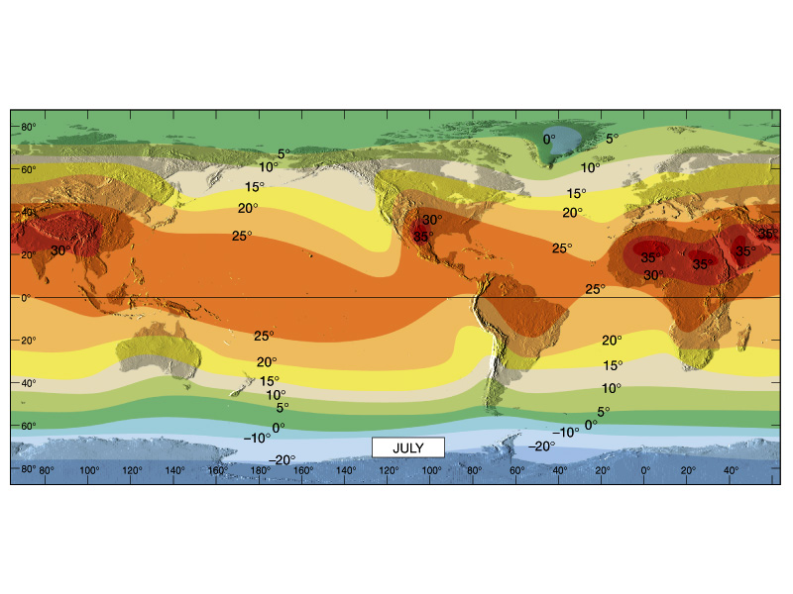
Global temperature trends – July (deg. Celsius)

Slide 13
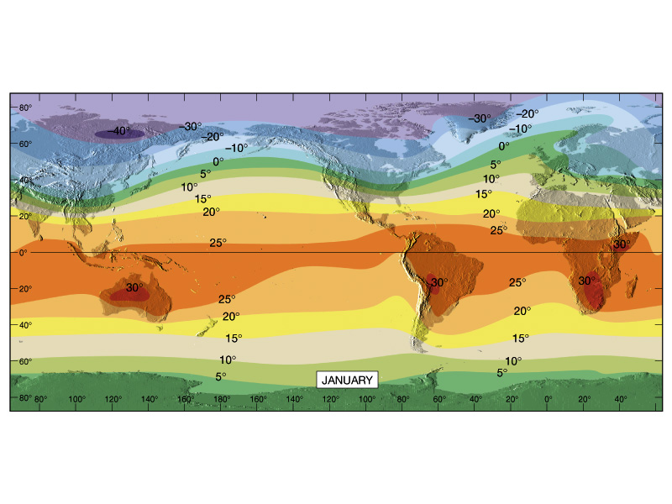
Global temperature trends – January (deg. Celsius)

Slide 14
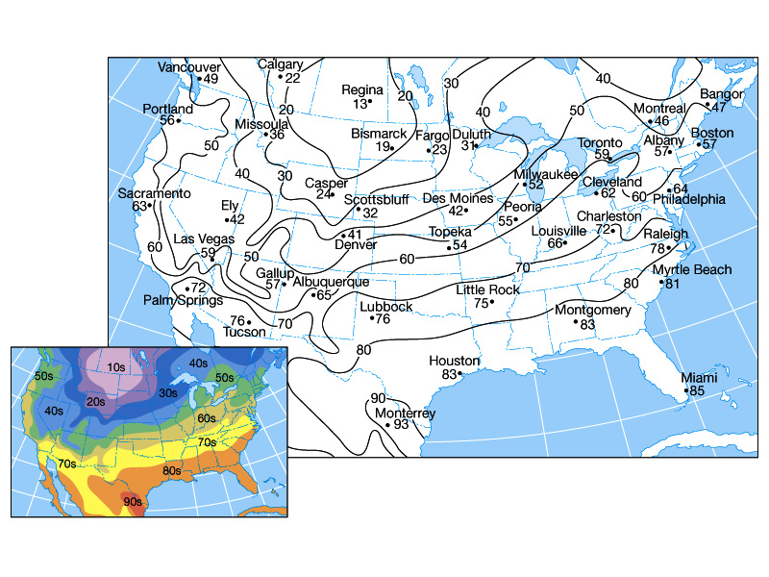
What season is it in the U.S. on this map?

Slide 15
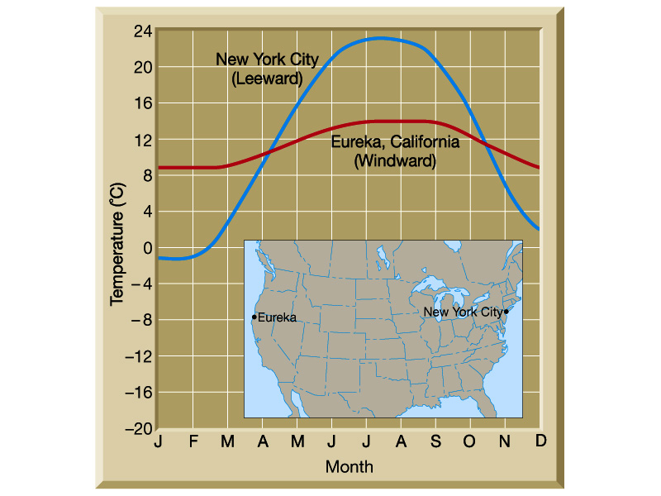

Slide 16
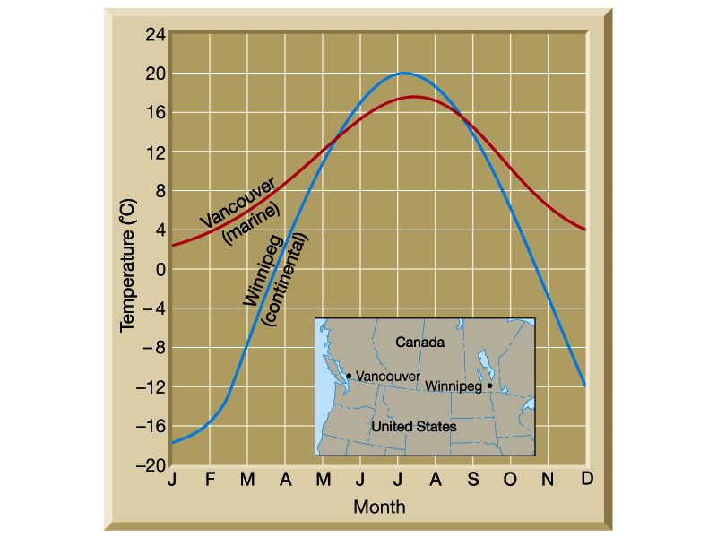
Maritime vs. continental air temp. trends

Slide 17
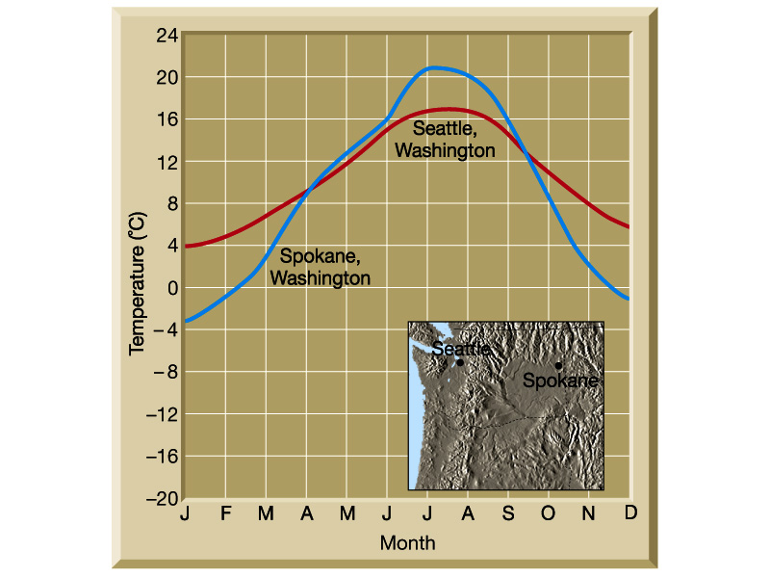
Maritime vs. continental air temp. trends

Slide 18
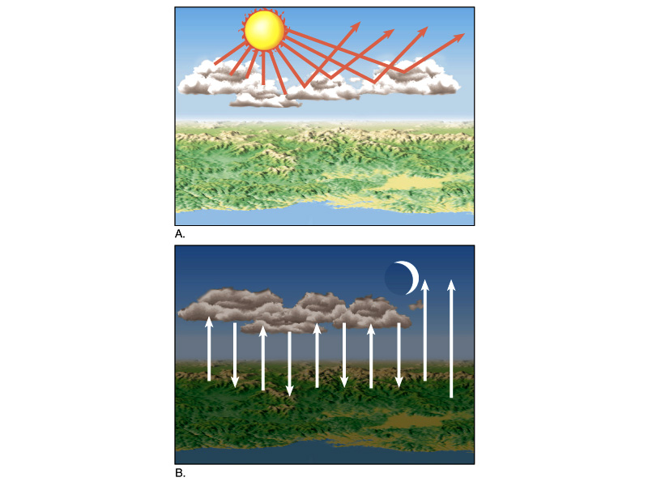
Effects of cloud
cover on surface
heating

Slide 19
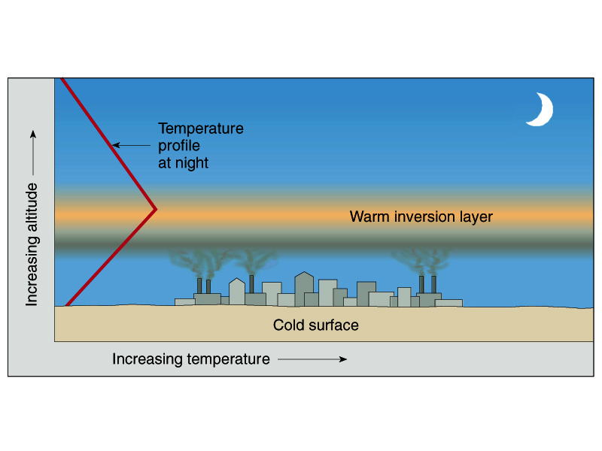

Slide 20
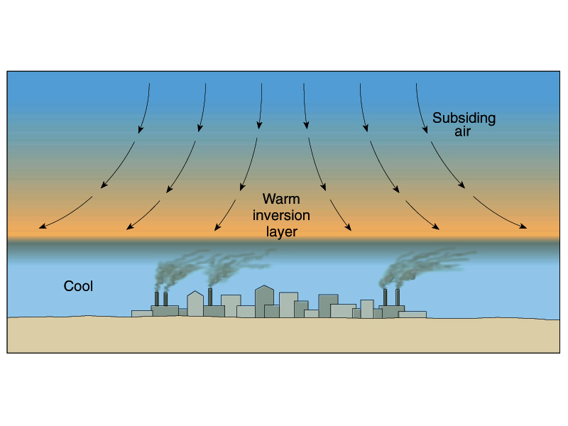

Slide 22
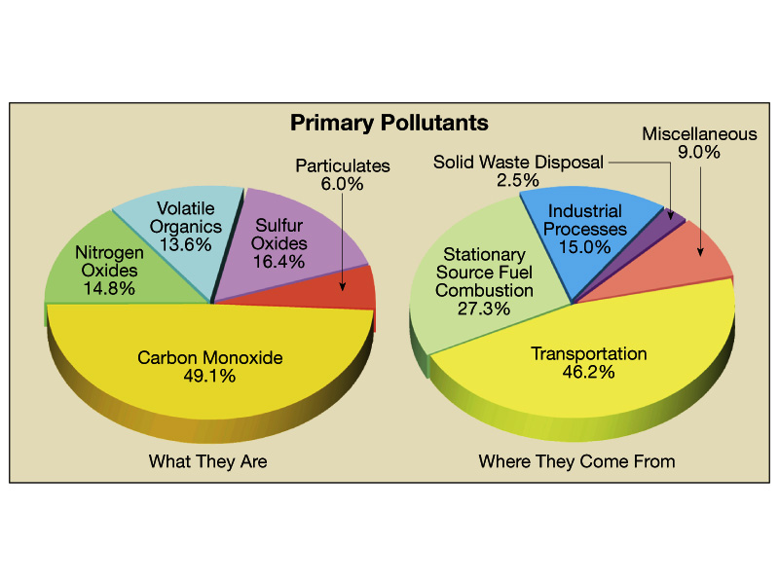
Air pollution sources

Slide 23
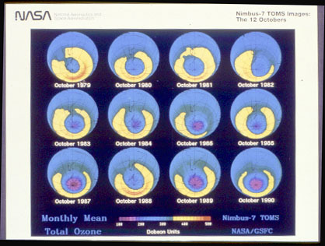
Ozone data

Slide 24
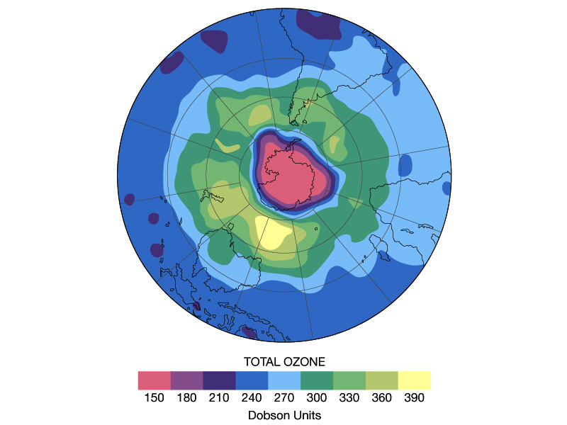
Hole in ozone
layer of stratosphere

Slide 25
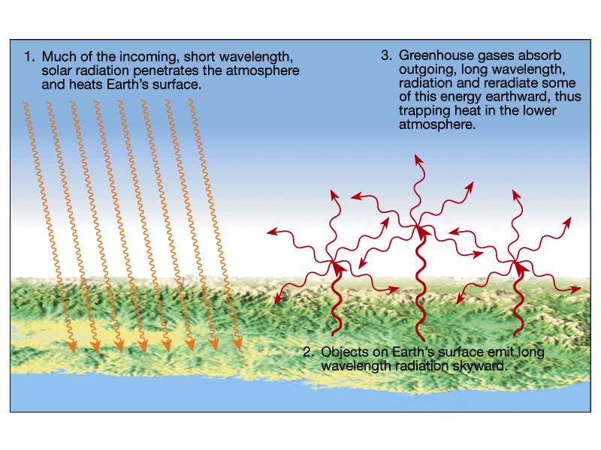
Greenhouse effect in Earth atmosphere

