Slide 1
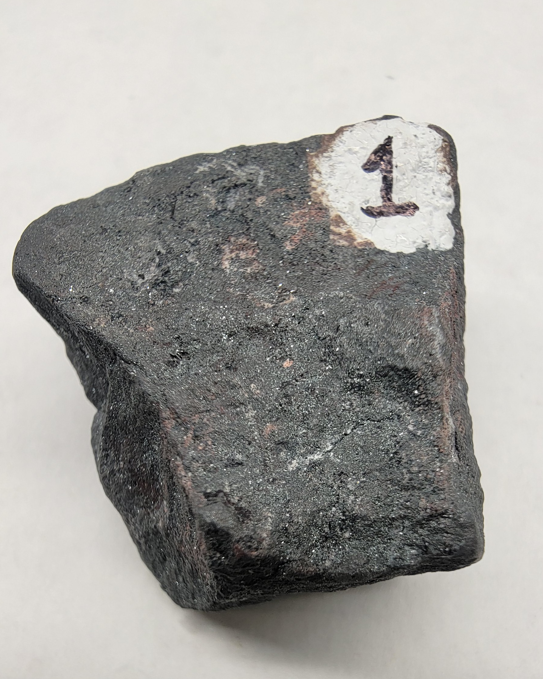
Sample 1
Hematite
Metallic luster, silver-gray color
Red Streak
absent cleavage
harder than glass, softer than nail
Iron oxide mineral

Slide 2
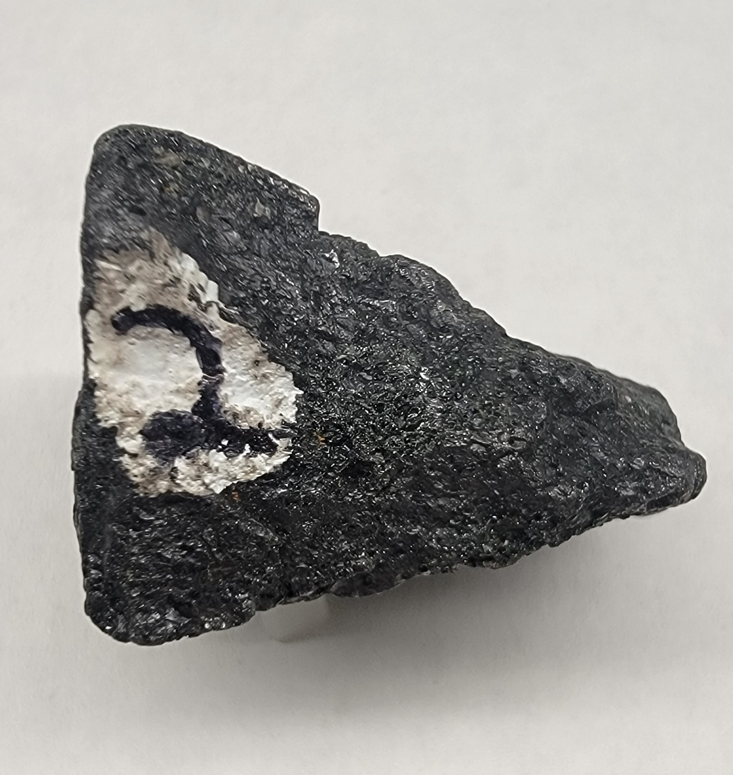
Sample 2
Magnetite
Metallic luster, dark color
Magnetic
Absent cleavage
iron oxide mineral

Slide 3
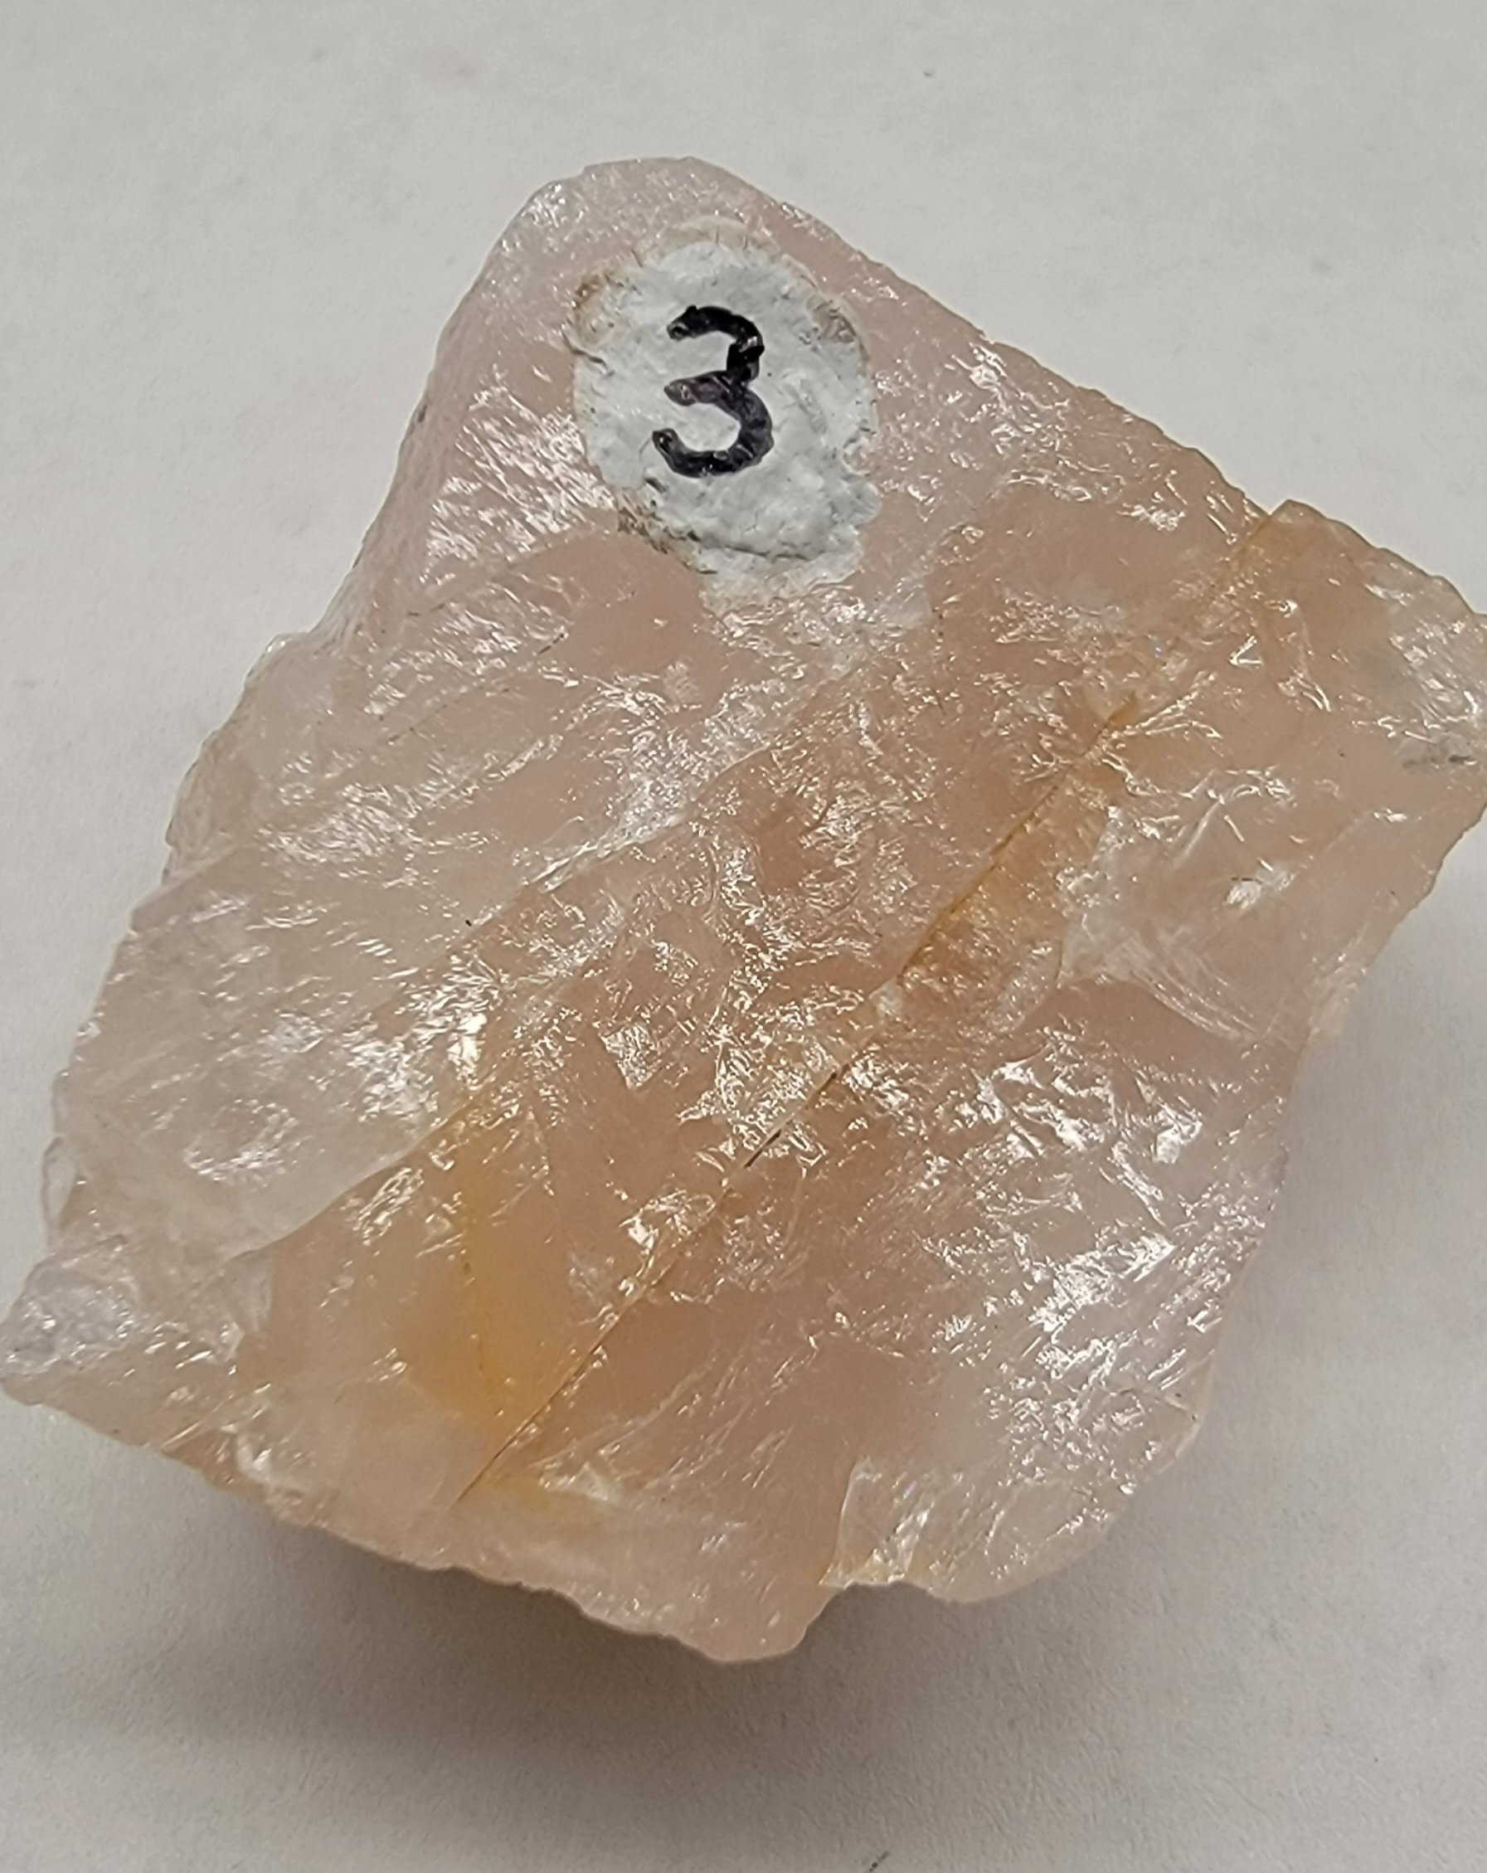
Sample 1
Quartz
Non-Metallic
Glassy luster
Absent cleavage
Conchoidal fracture
Harder than glass
Harder than nail
felsic, light colored silicate mineral

Slide 4
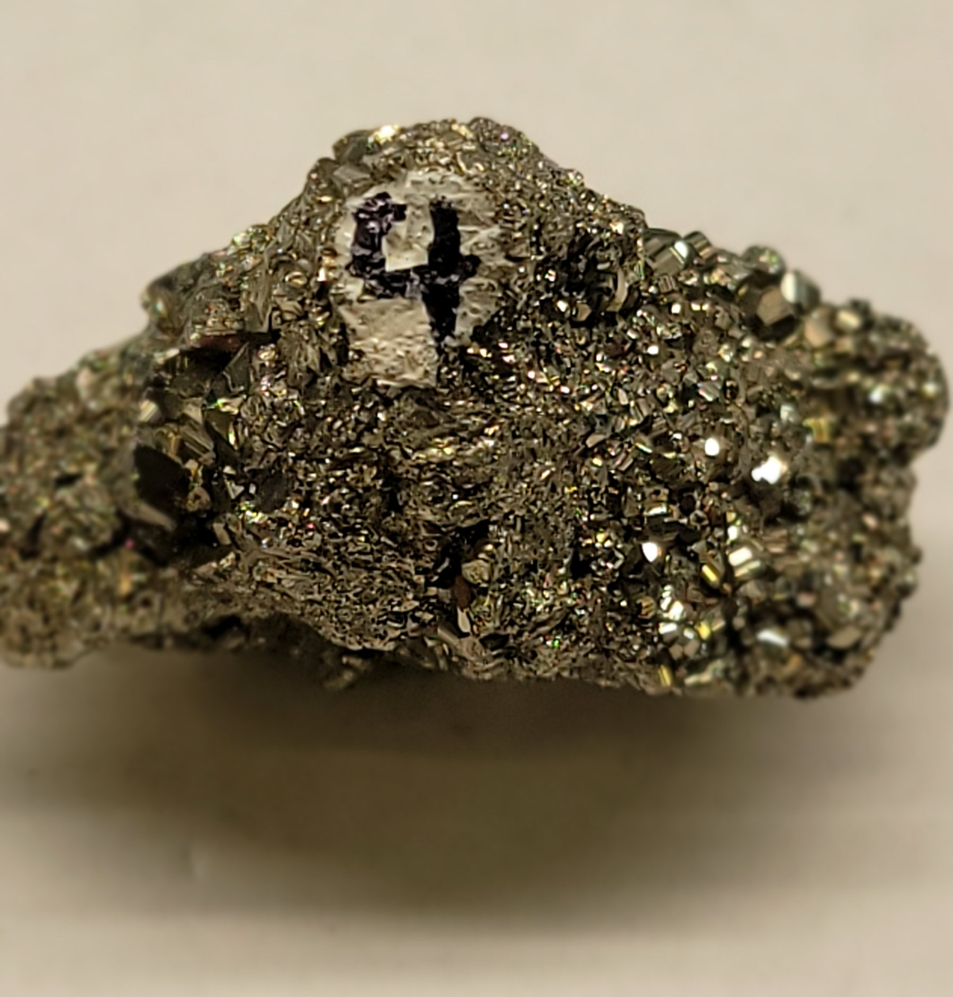
Sample 4
Pyrite
Metallic luster
Black Streak
Absent cleavage
5-sided crystals
Softer than nail, harder than glass
iron sulfide mineral
fools gold

Slide 5
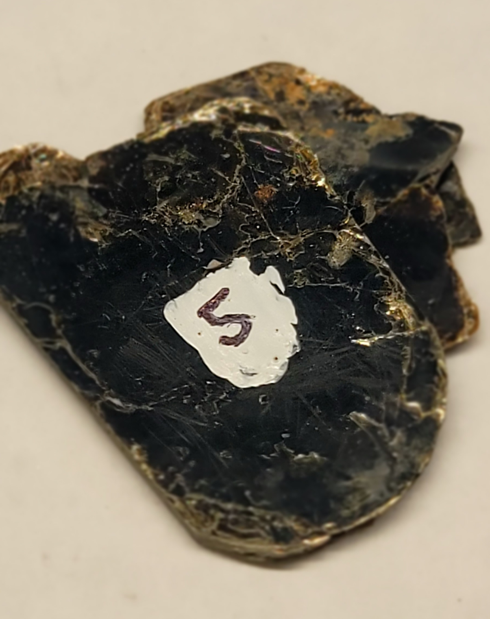
Sample 5
Biotite
Non-Metallic luster, dark colored
One-direction cleavage (paper sheets)
softer than glass
mafic, dark color, silicate mineral

Slide 6
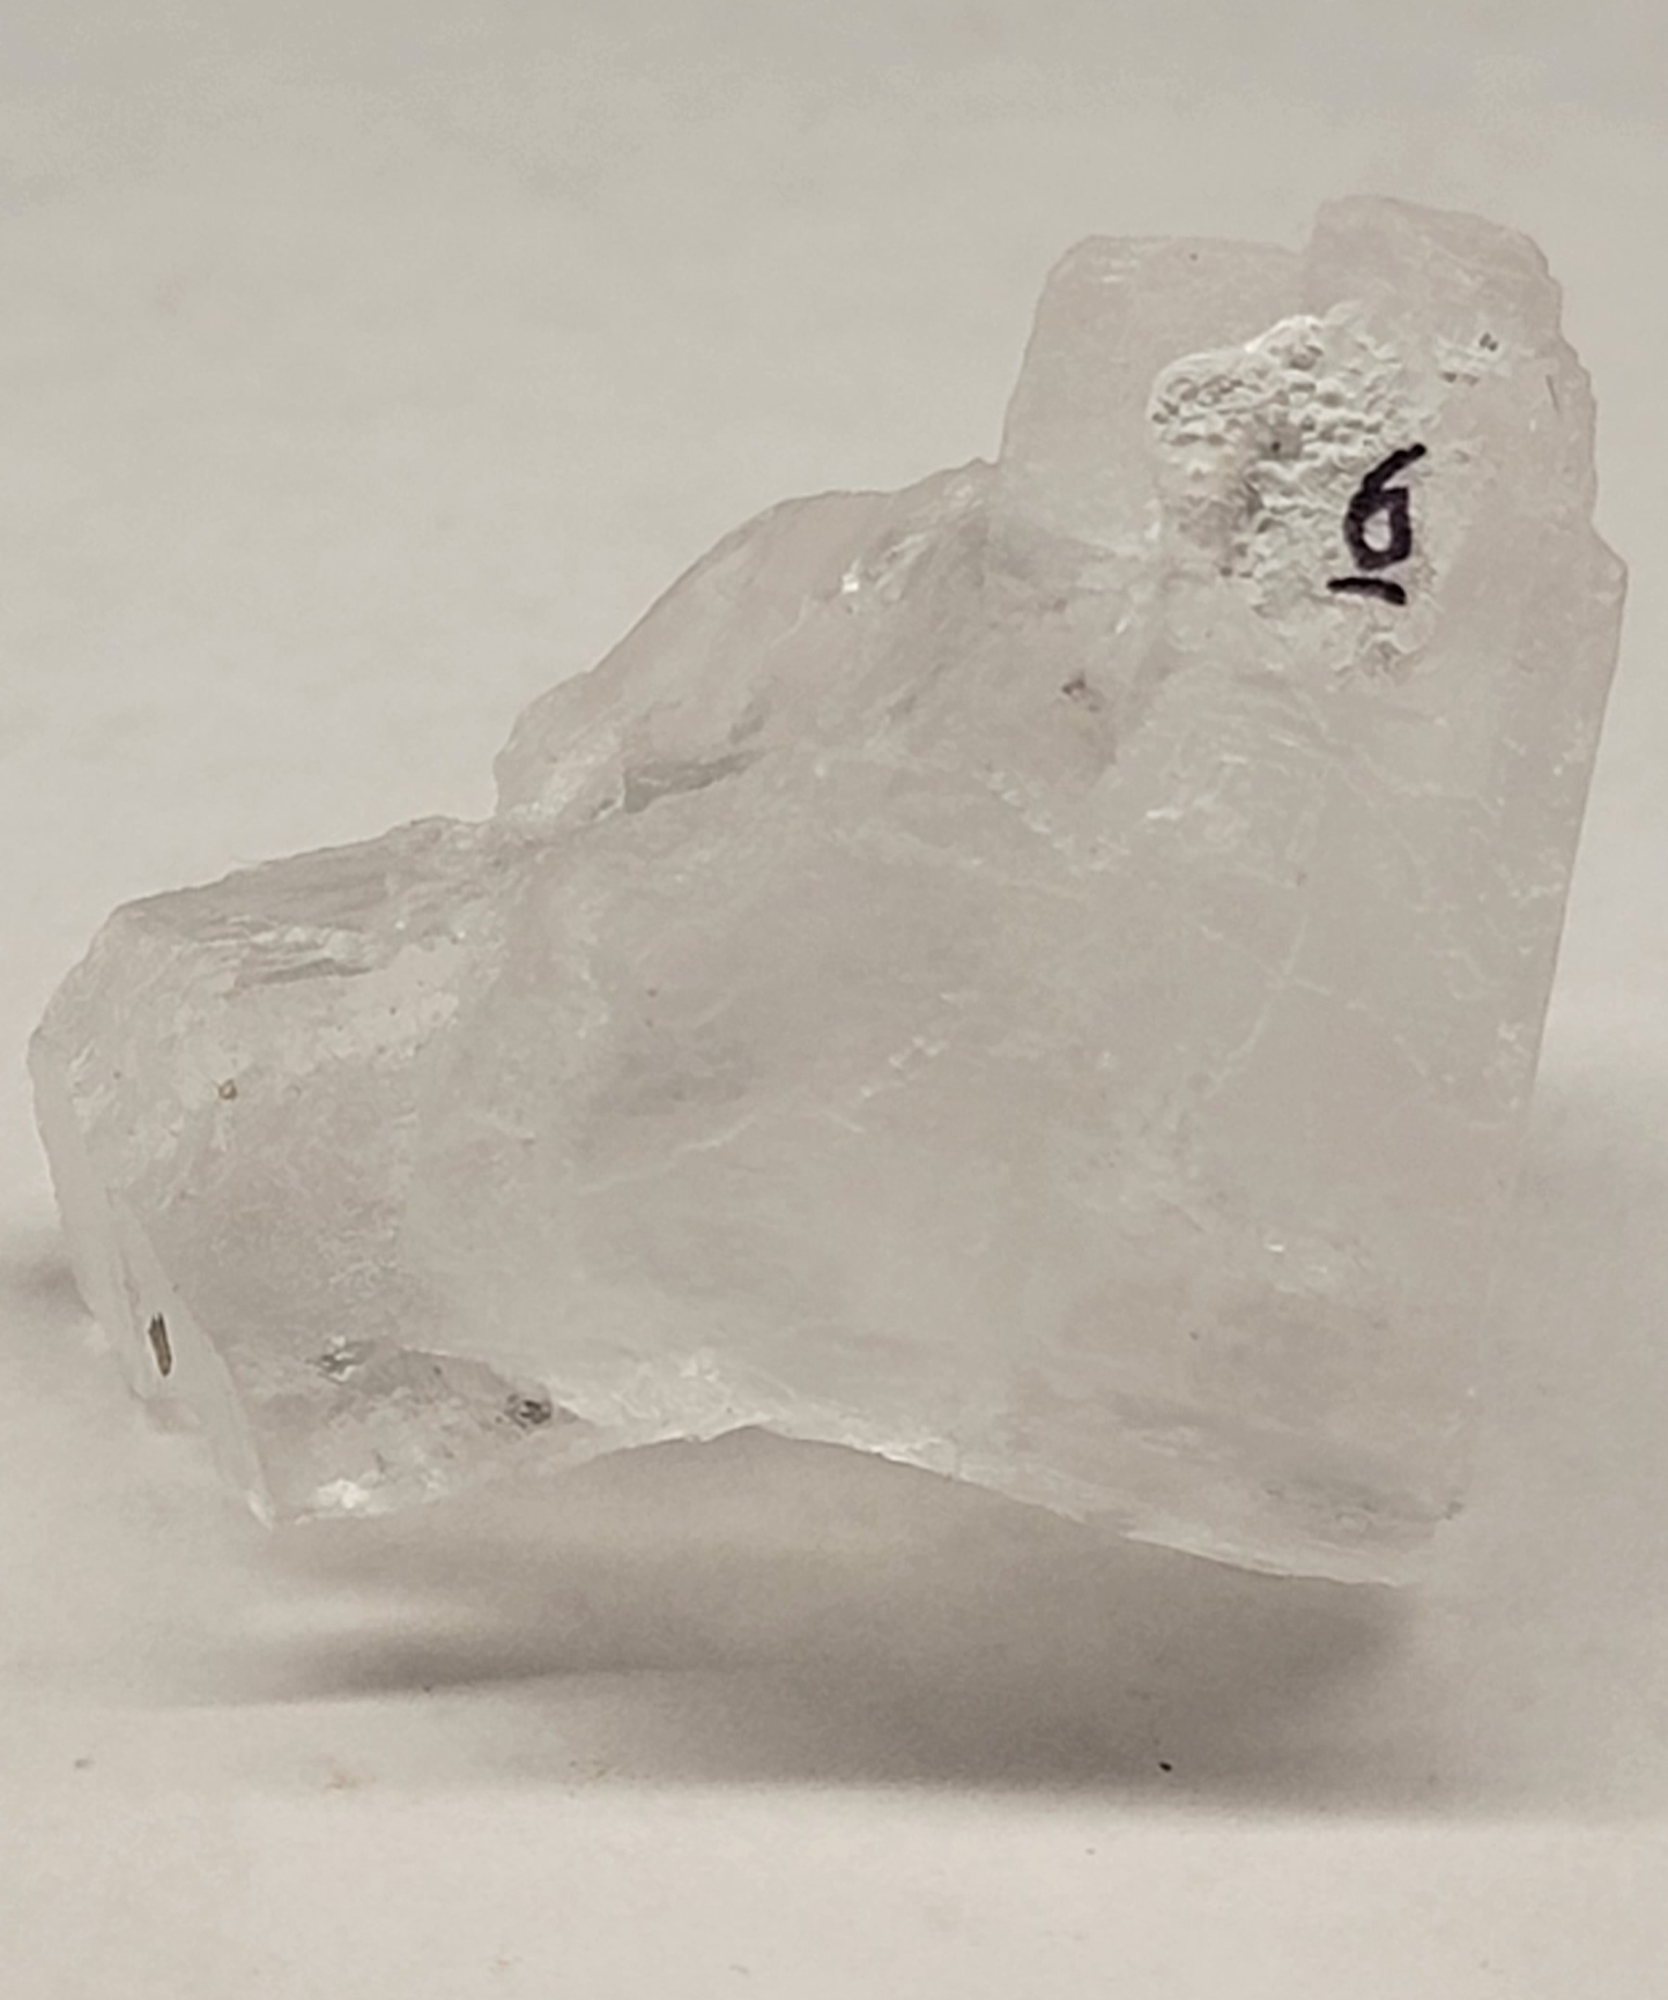
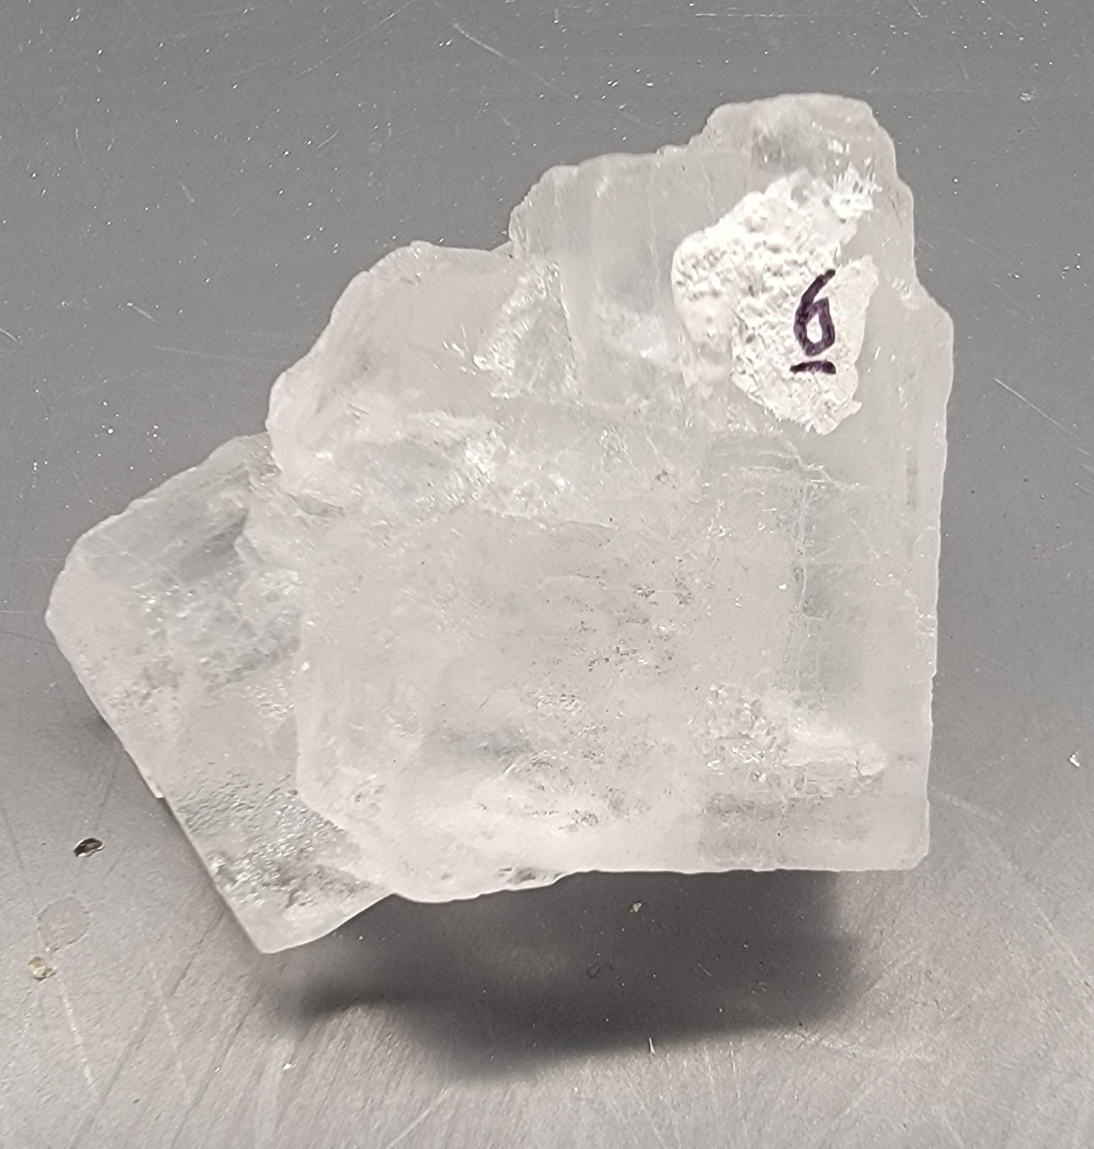
Sample 6
Halite
Non-Metallic, light color
3-directions cleavage (cubes)
softer than glass
salty taste
translucent, NaCl

Slide 7
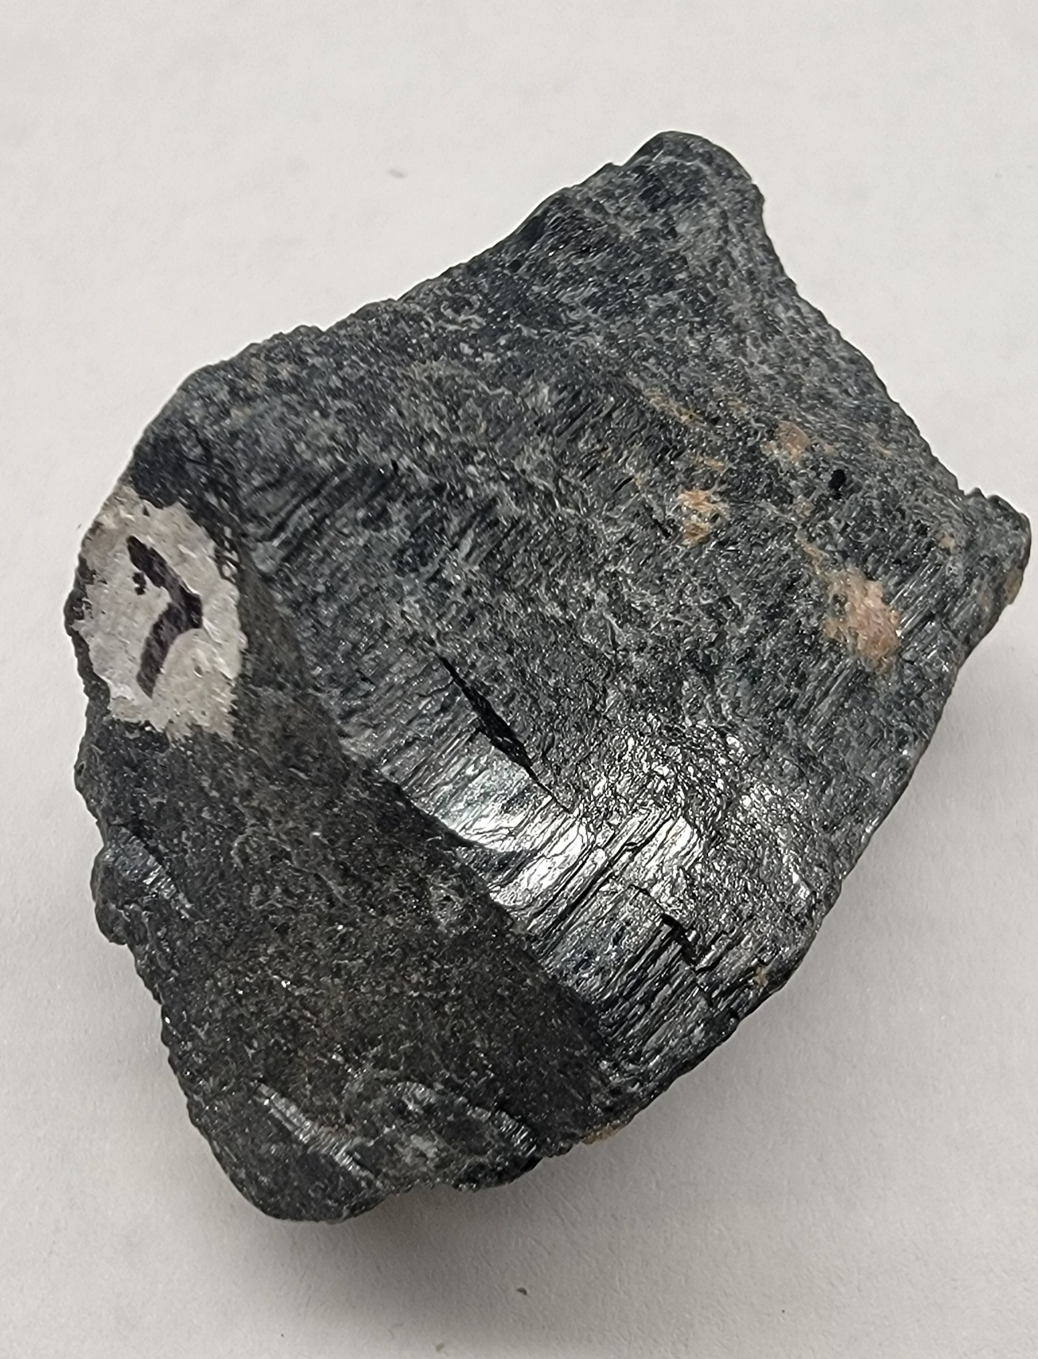
Sample 7
Hornblende (amphibole)
Non-Metallic luster, dark color
2-directions cleavage (wood grain appearance)
softer than nail, harder than glass
mafic, dark-colored silicate mineral

Slide 8
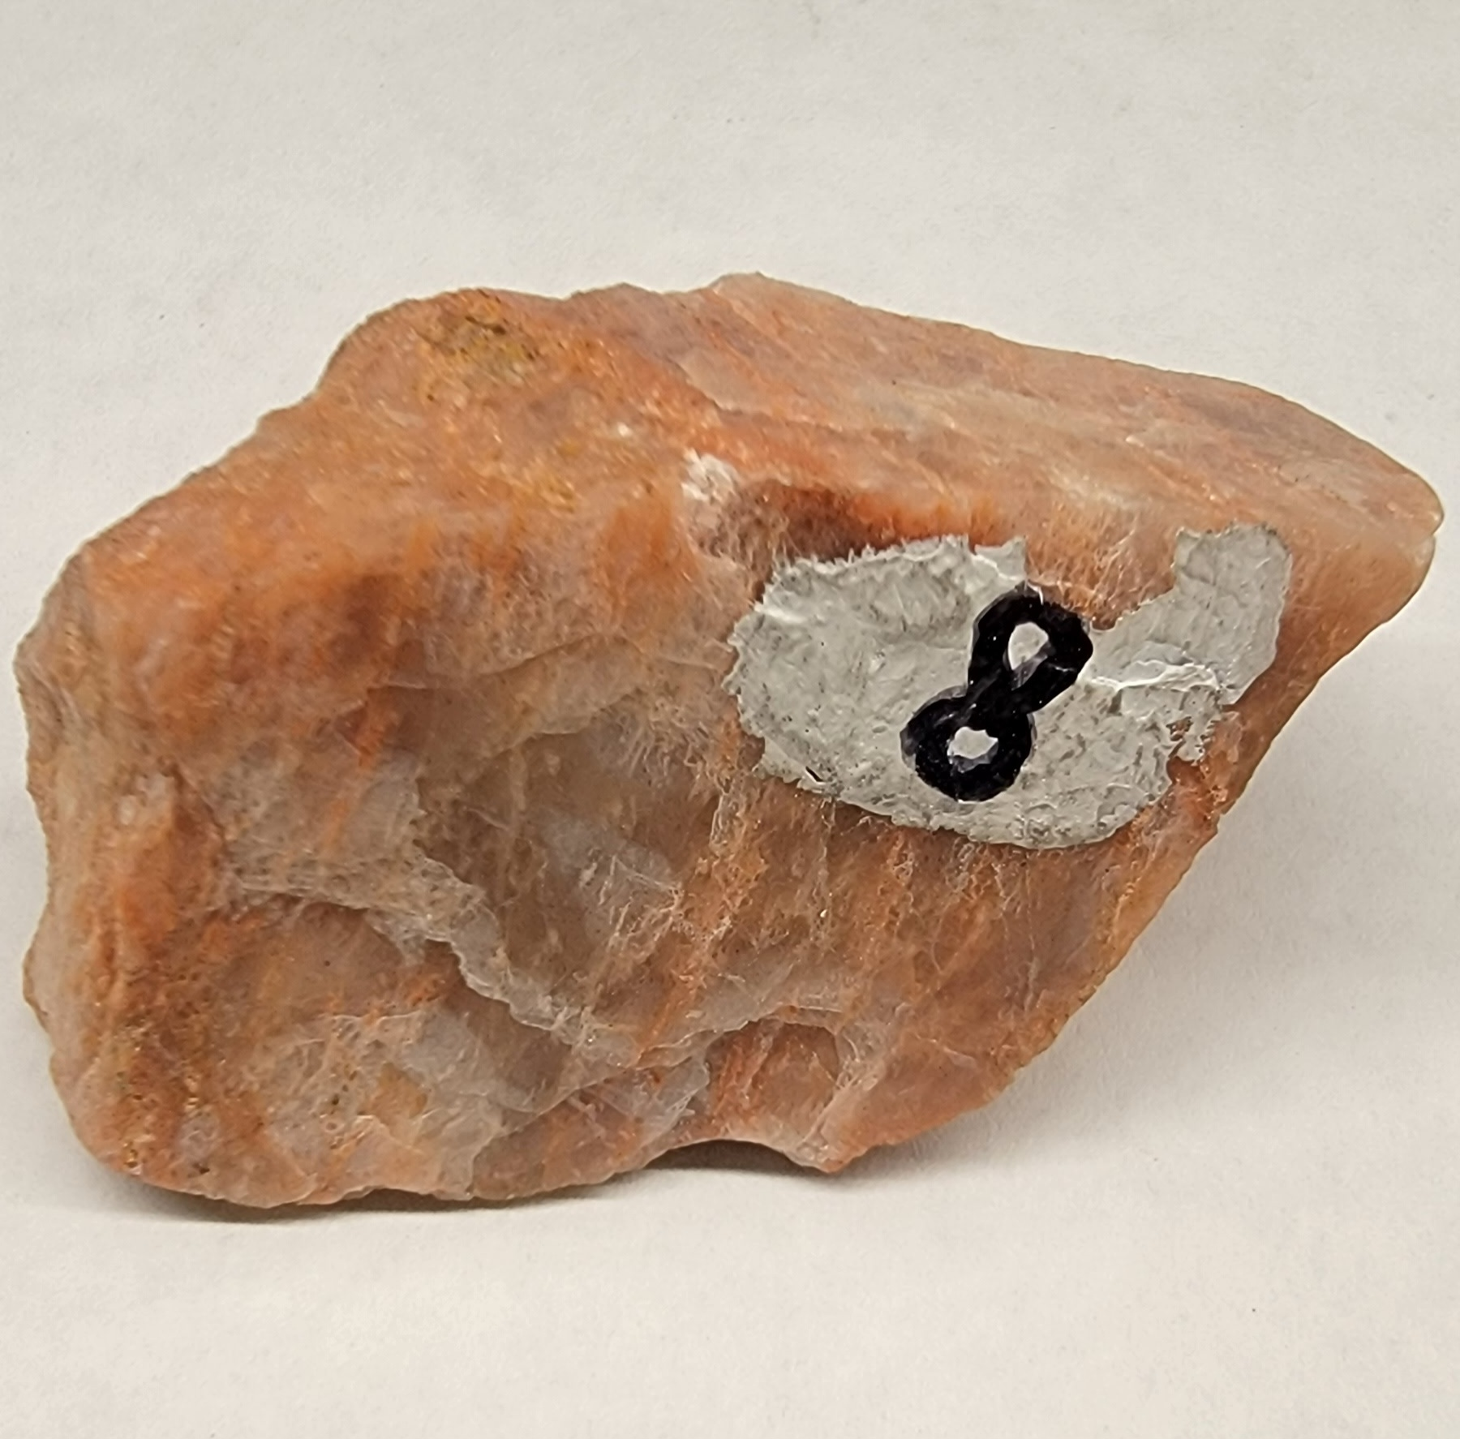
Sample 8
Orthoclase (potassium feldspar, k-spar)
Non-Metallic luster, light color
white to pink, with threaded bands
2-directions cleavage
softer than nail, harder than glass
felsic, light-colored, pink silicate mineral

Slide 9
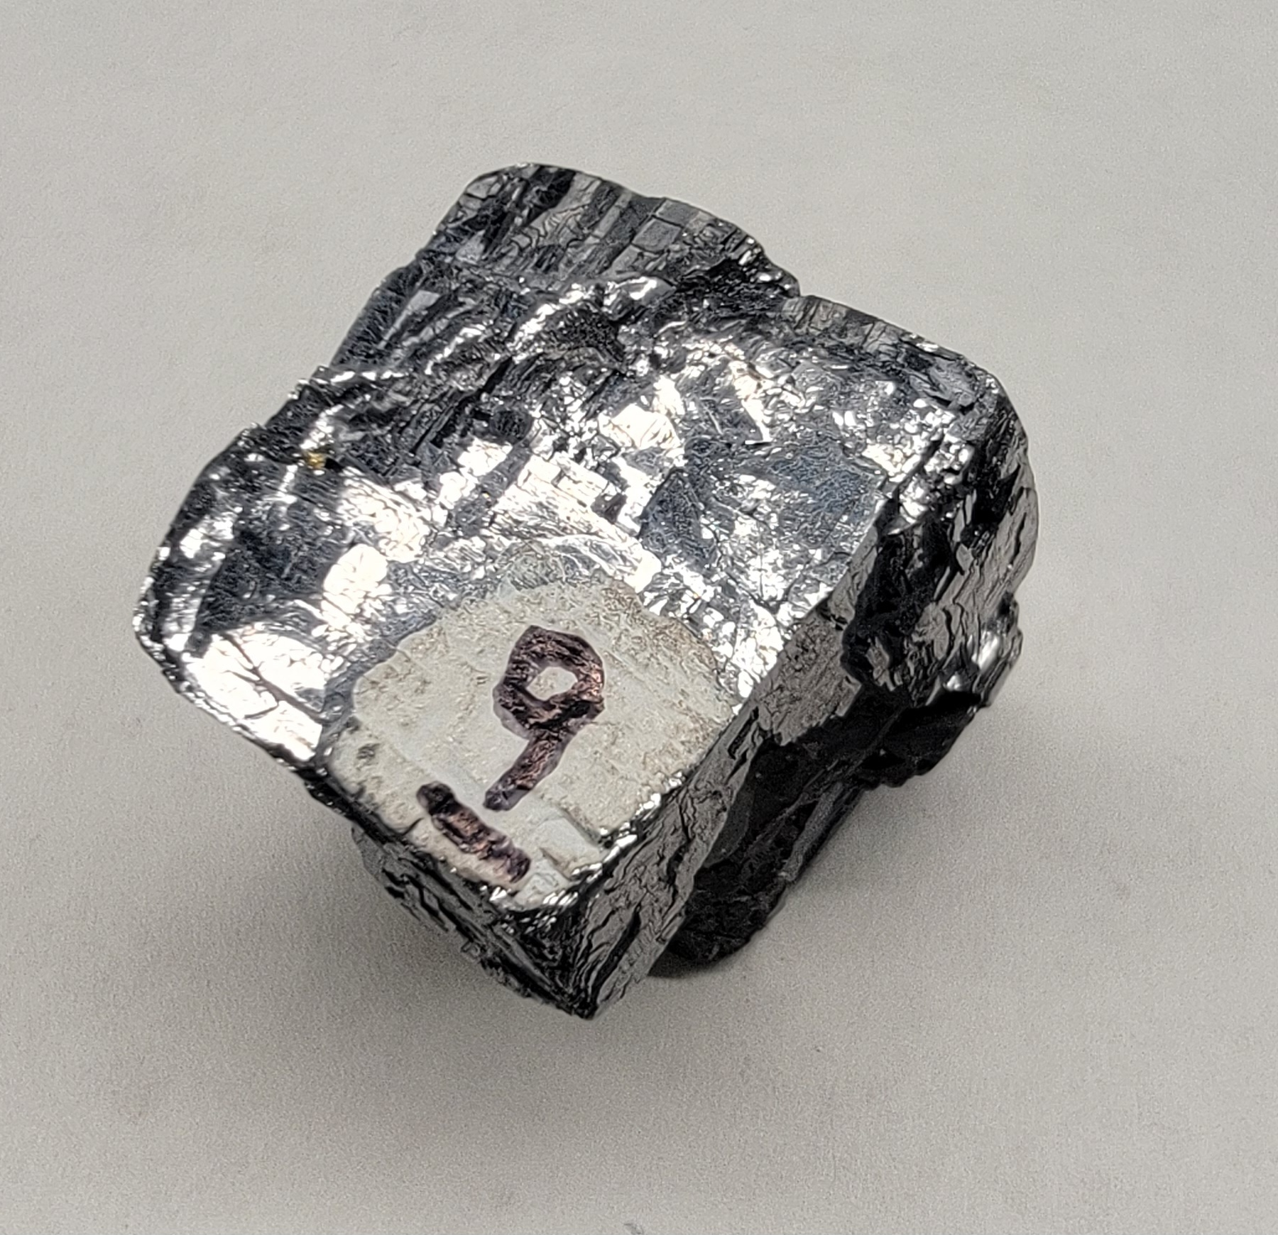
Sample 9
Galena
Metallic luster
softer than glass
3-directions cleavage, cubic
softer than nail
dense and heavy feel
lead sulfide mineral

Slide 10
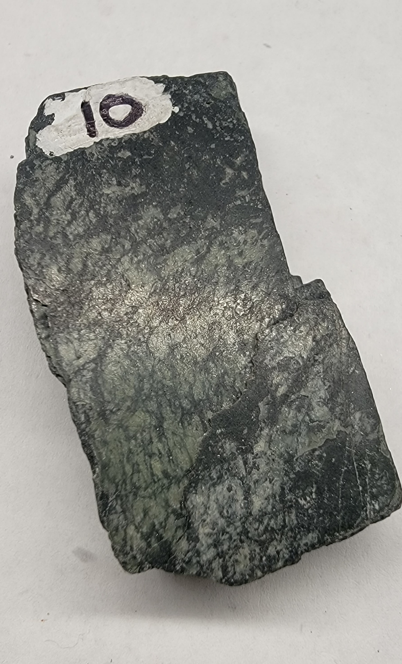
Sample 10
augite
Non-Metallic
2-directions cleavage
softer than nail, harder than glass
dark green coloration
mafic, dark-colored silicate mineral

Slide 11
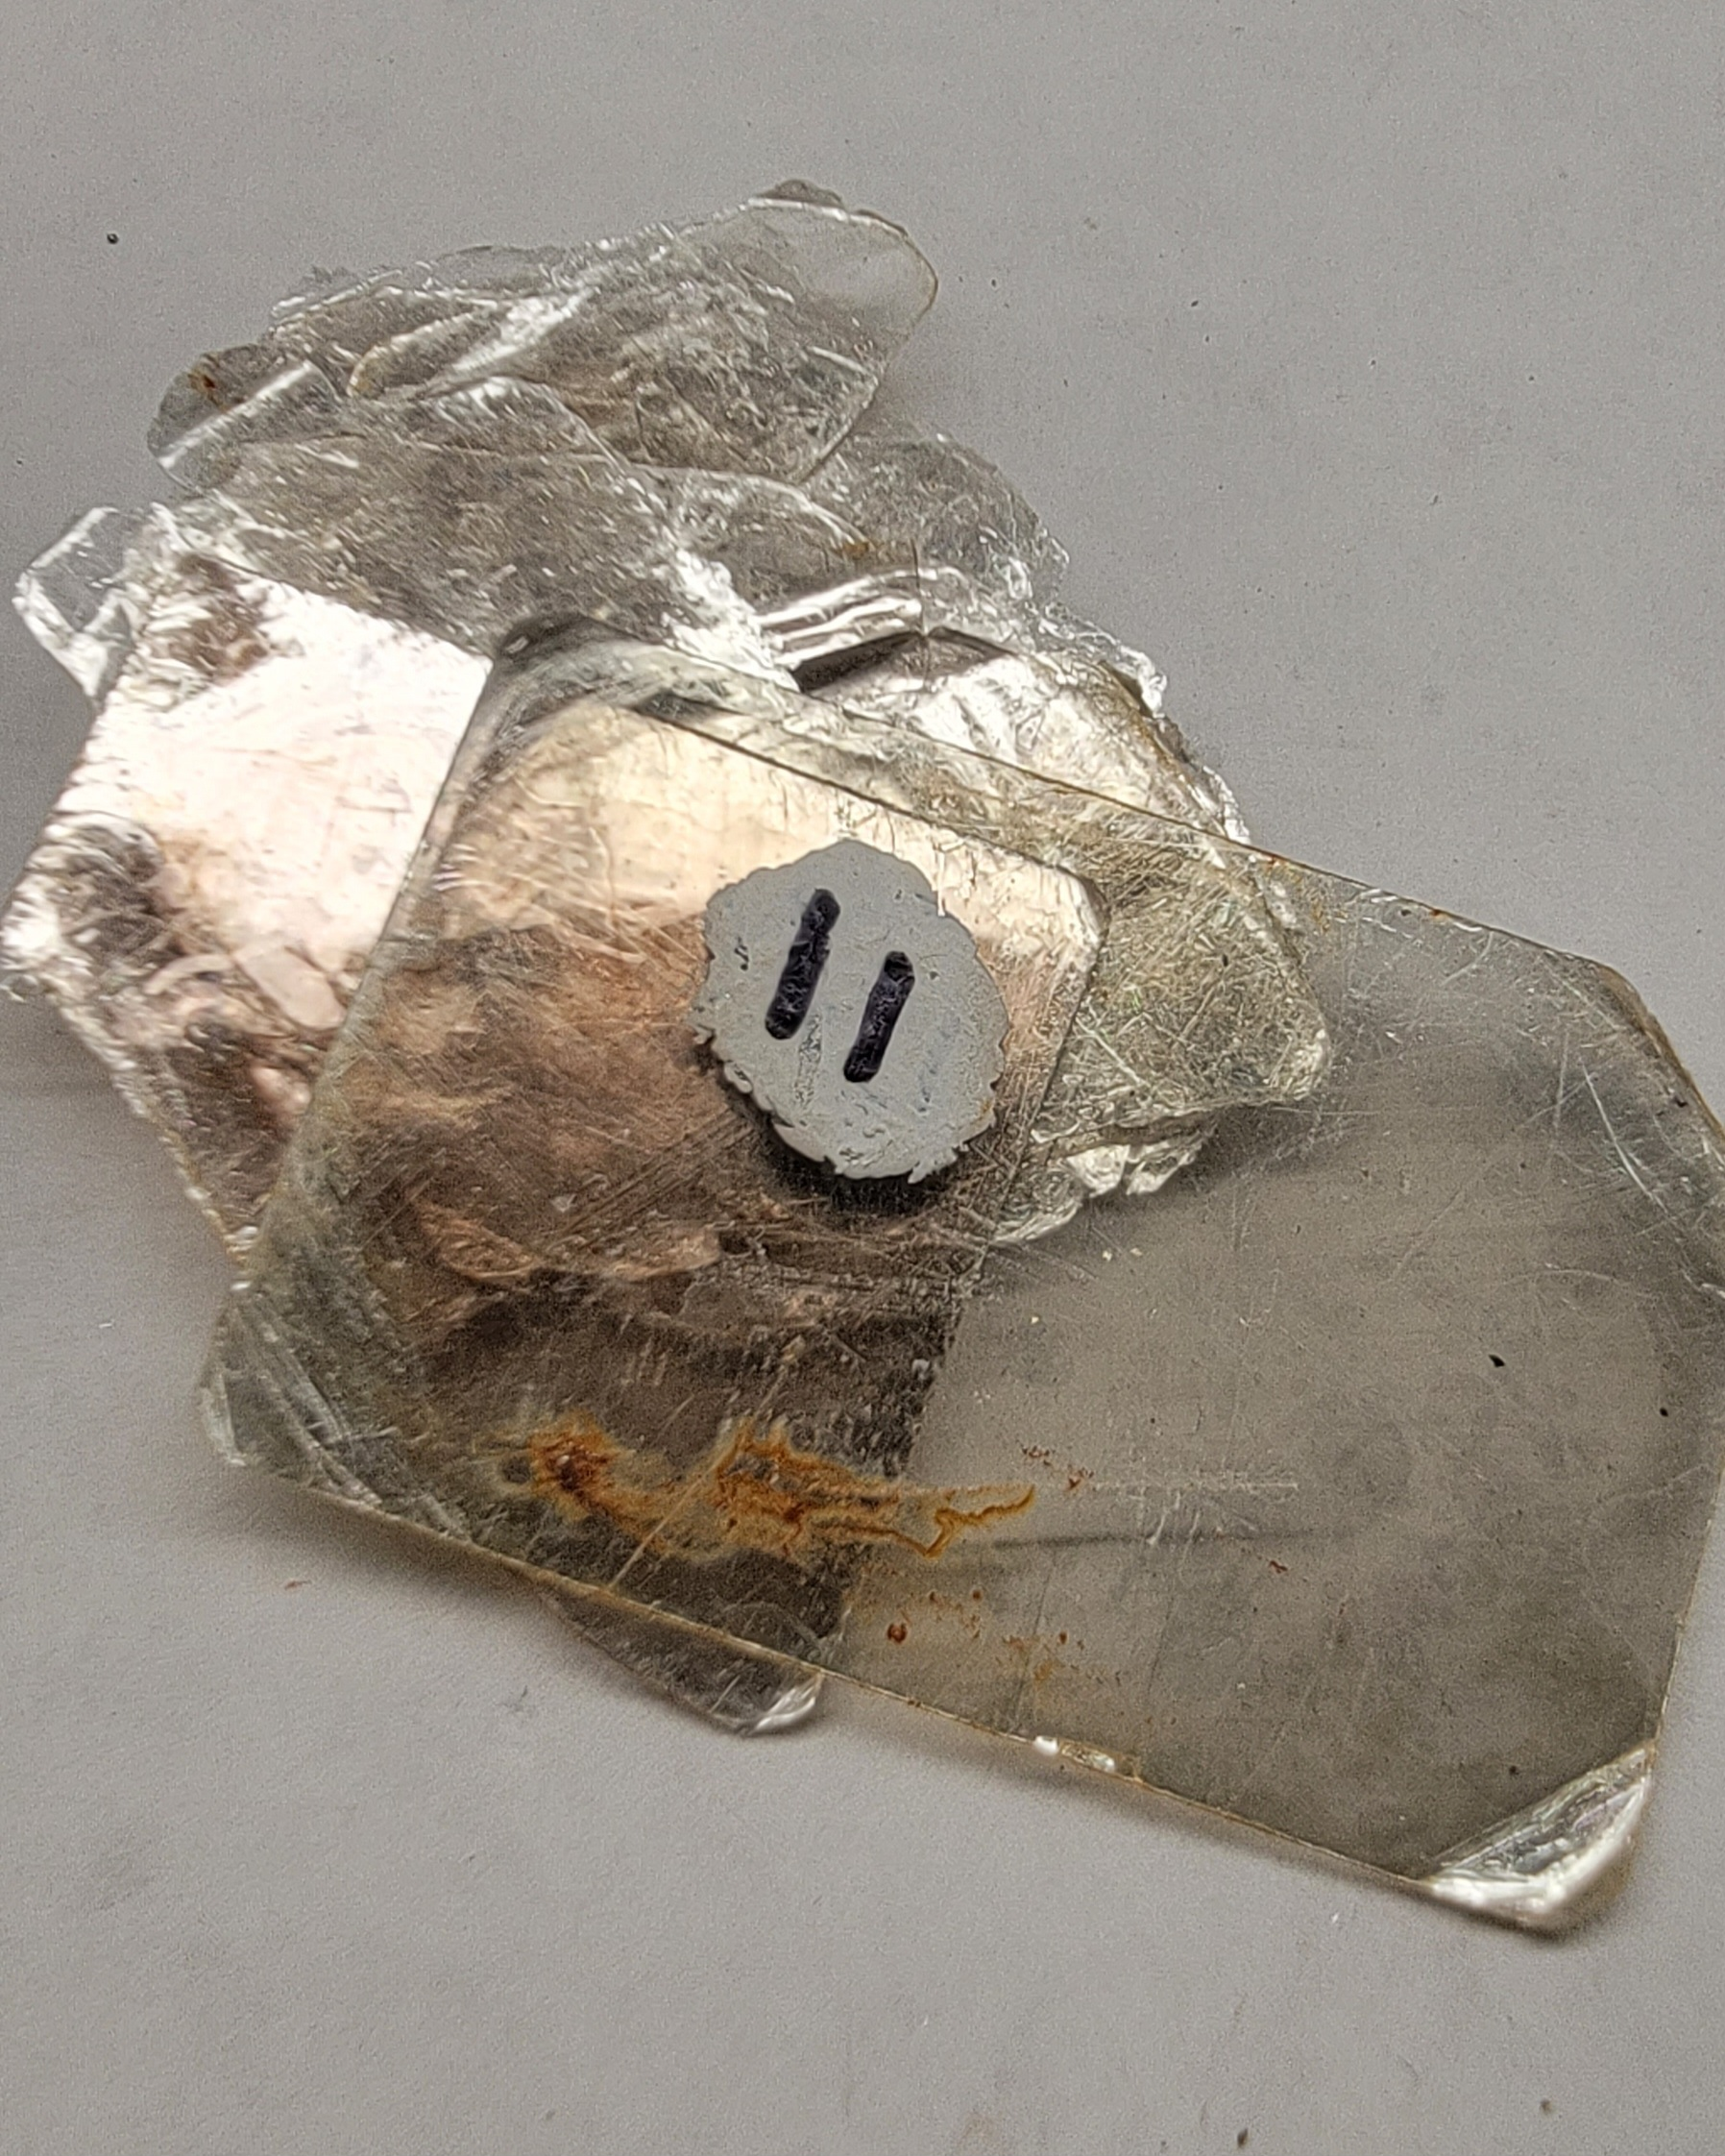
Sample 11
Muscovite
Non-Metallic luster, light to transparent
One-direction cleavage (paper sheets)
softer than glass
felsic, light color, silicate mineral

Slide 12
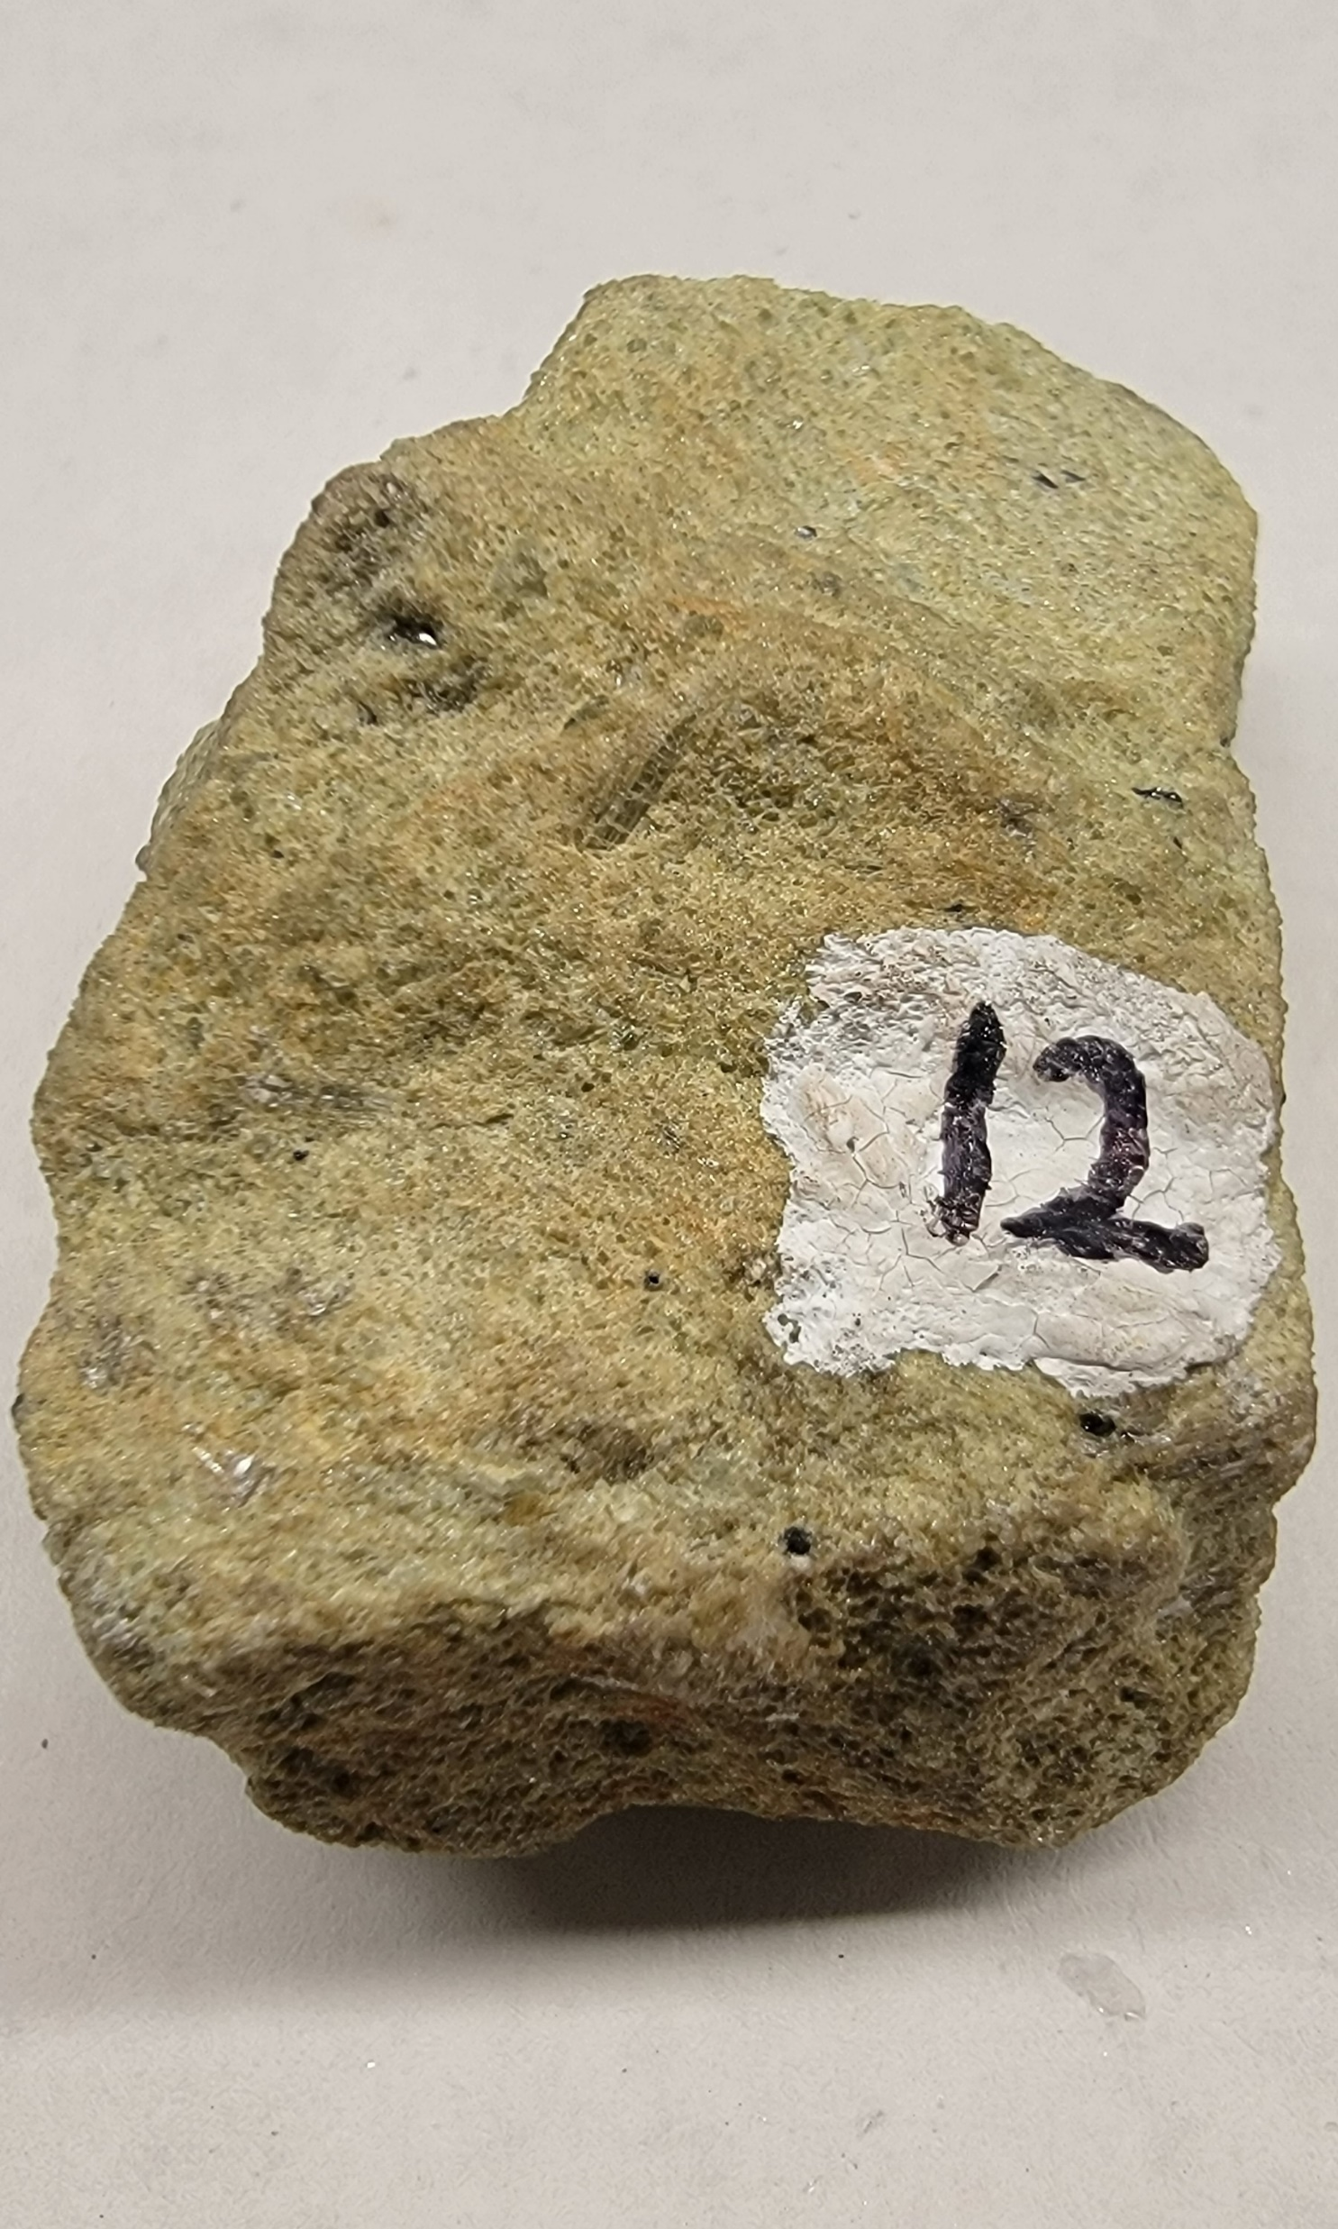
Sample 12
olivine
Non-Metallic luster, dark colored
absent cleavage
harder than glass
olive green coloration
mafic, dark-colored silicate mineral

Slide 13
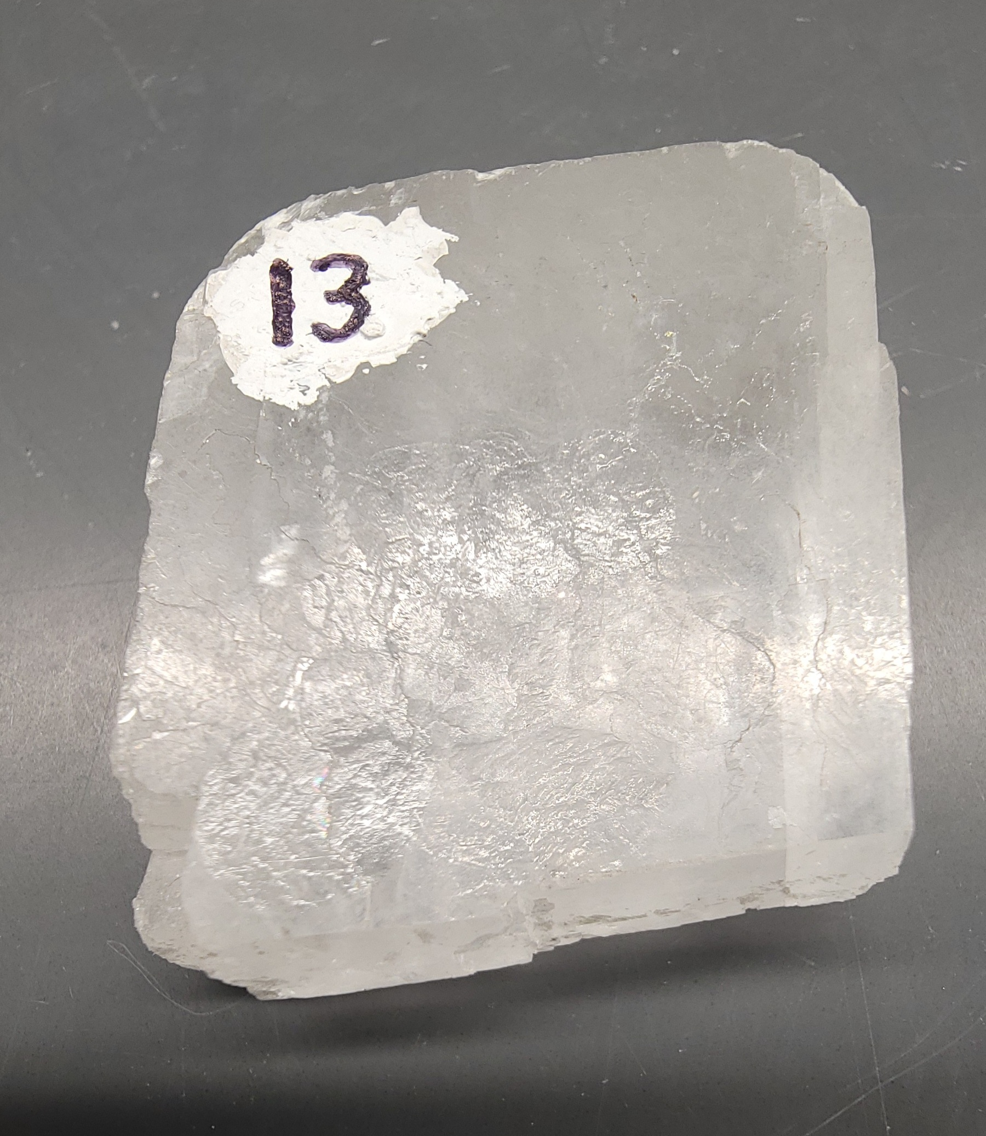
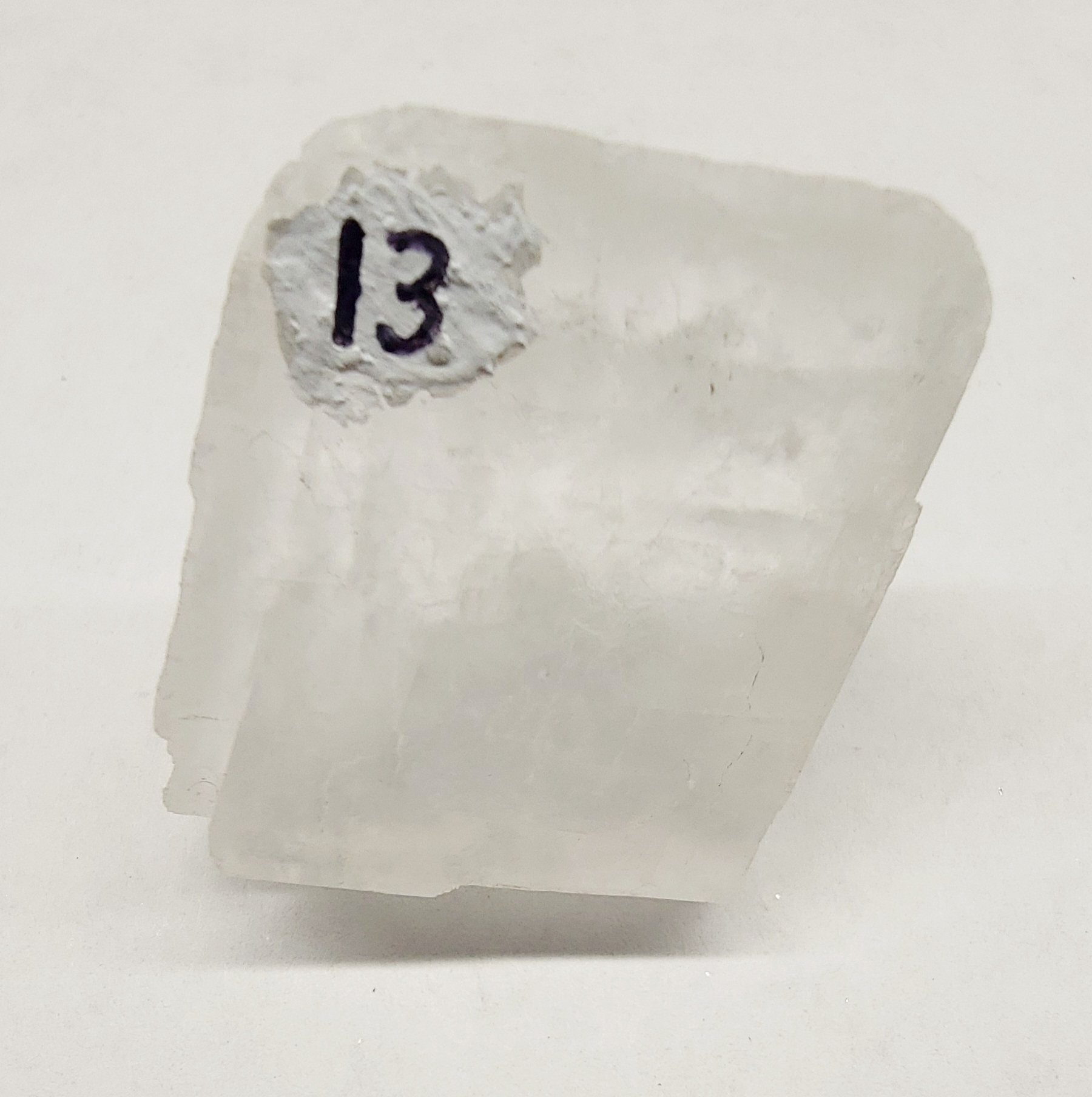
Sample 13
Calcite
Non-Metallic
3-directions cleavage (rhomohedral)
softer than nail, softer than glass
fizzes (effervesces) with acid drop
calcium carbonate mineral

Slide 14
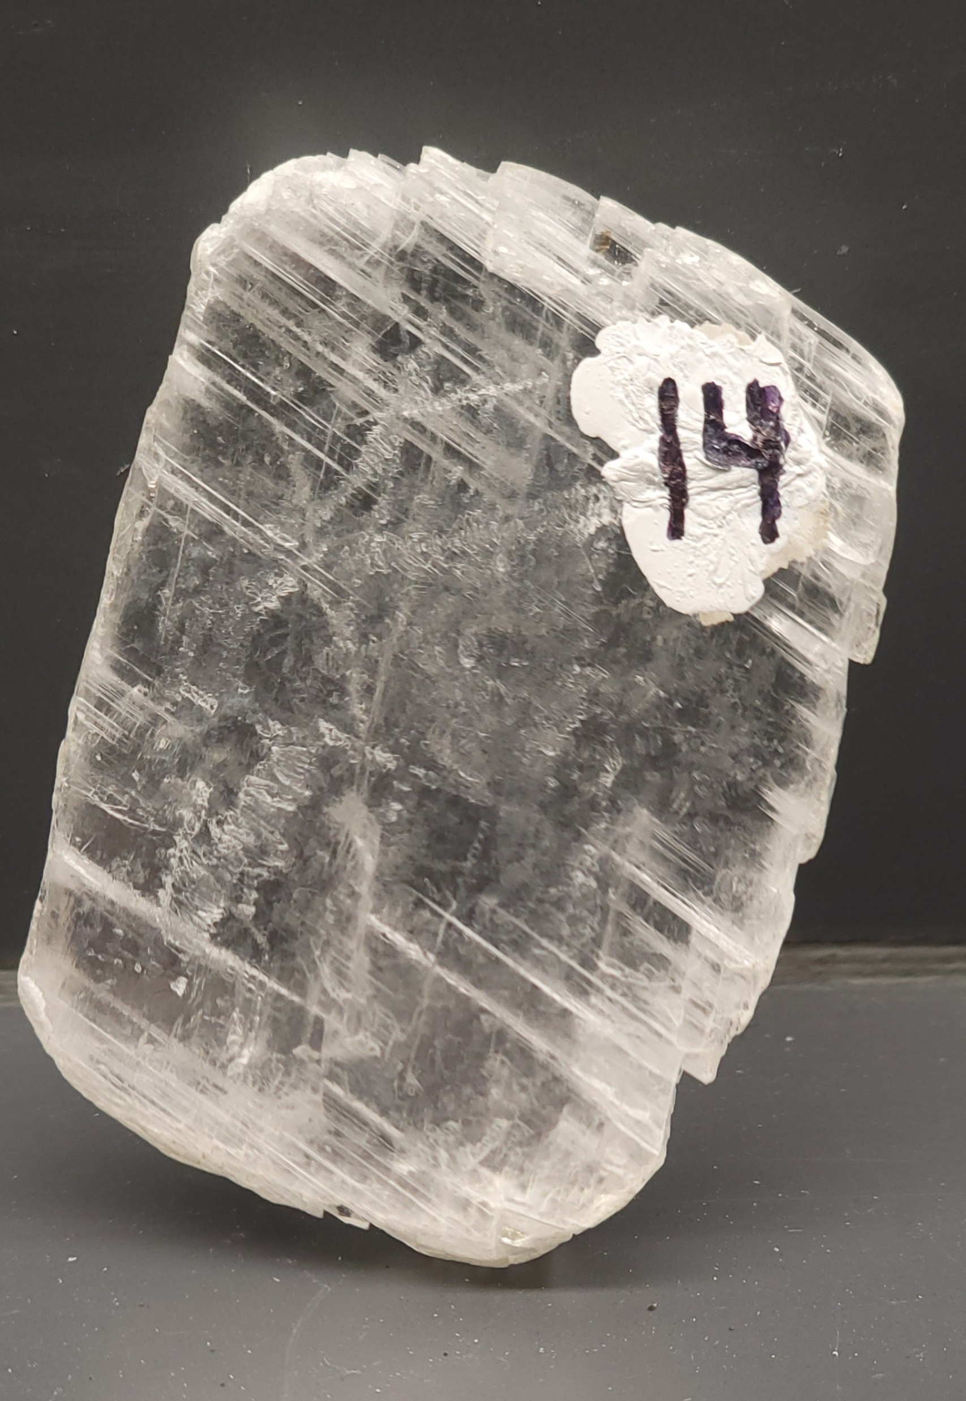
Sample 14
gypsum
Non-Metallic, light color
white to clear
one good-directions cleavage, 2 poor
softer than fingernail
does not fizz with acid
calcium sulfate mineral

Slide 15
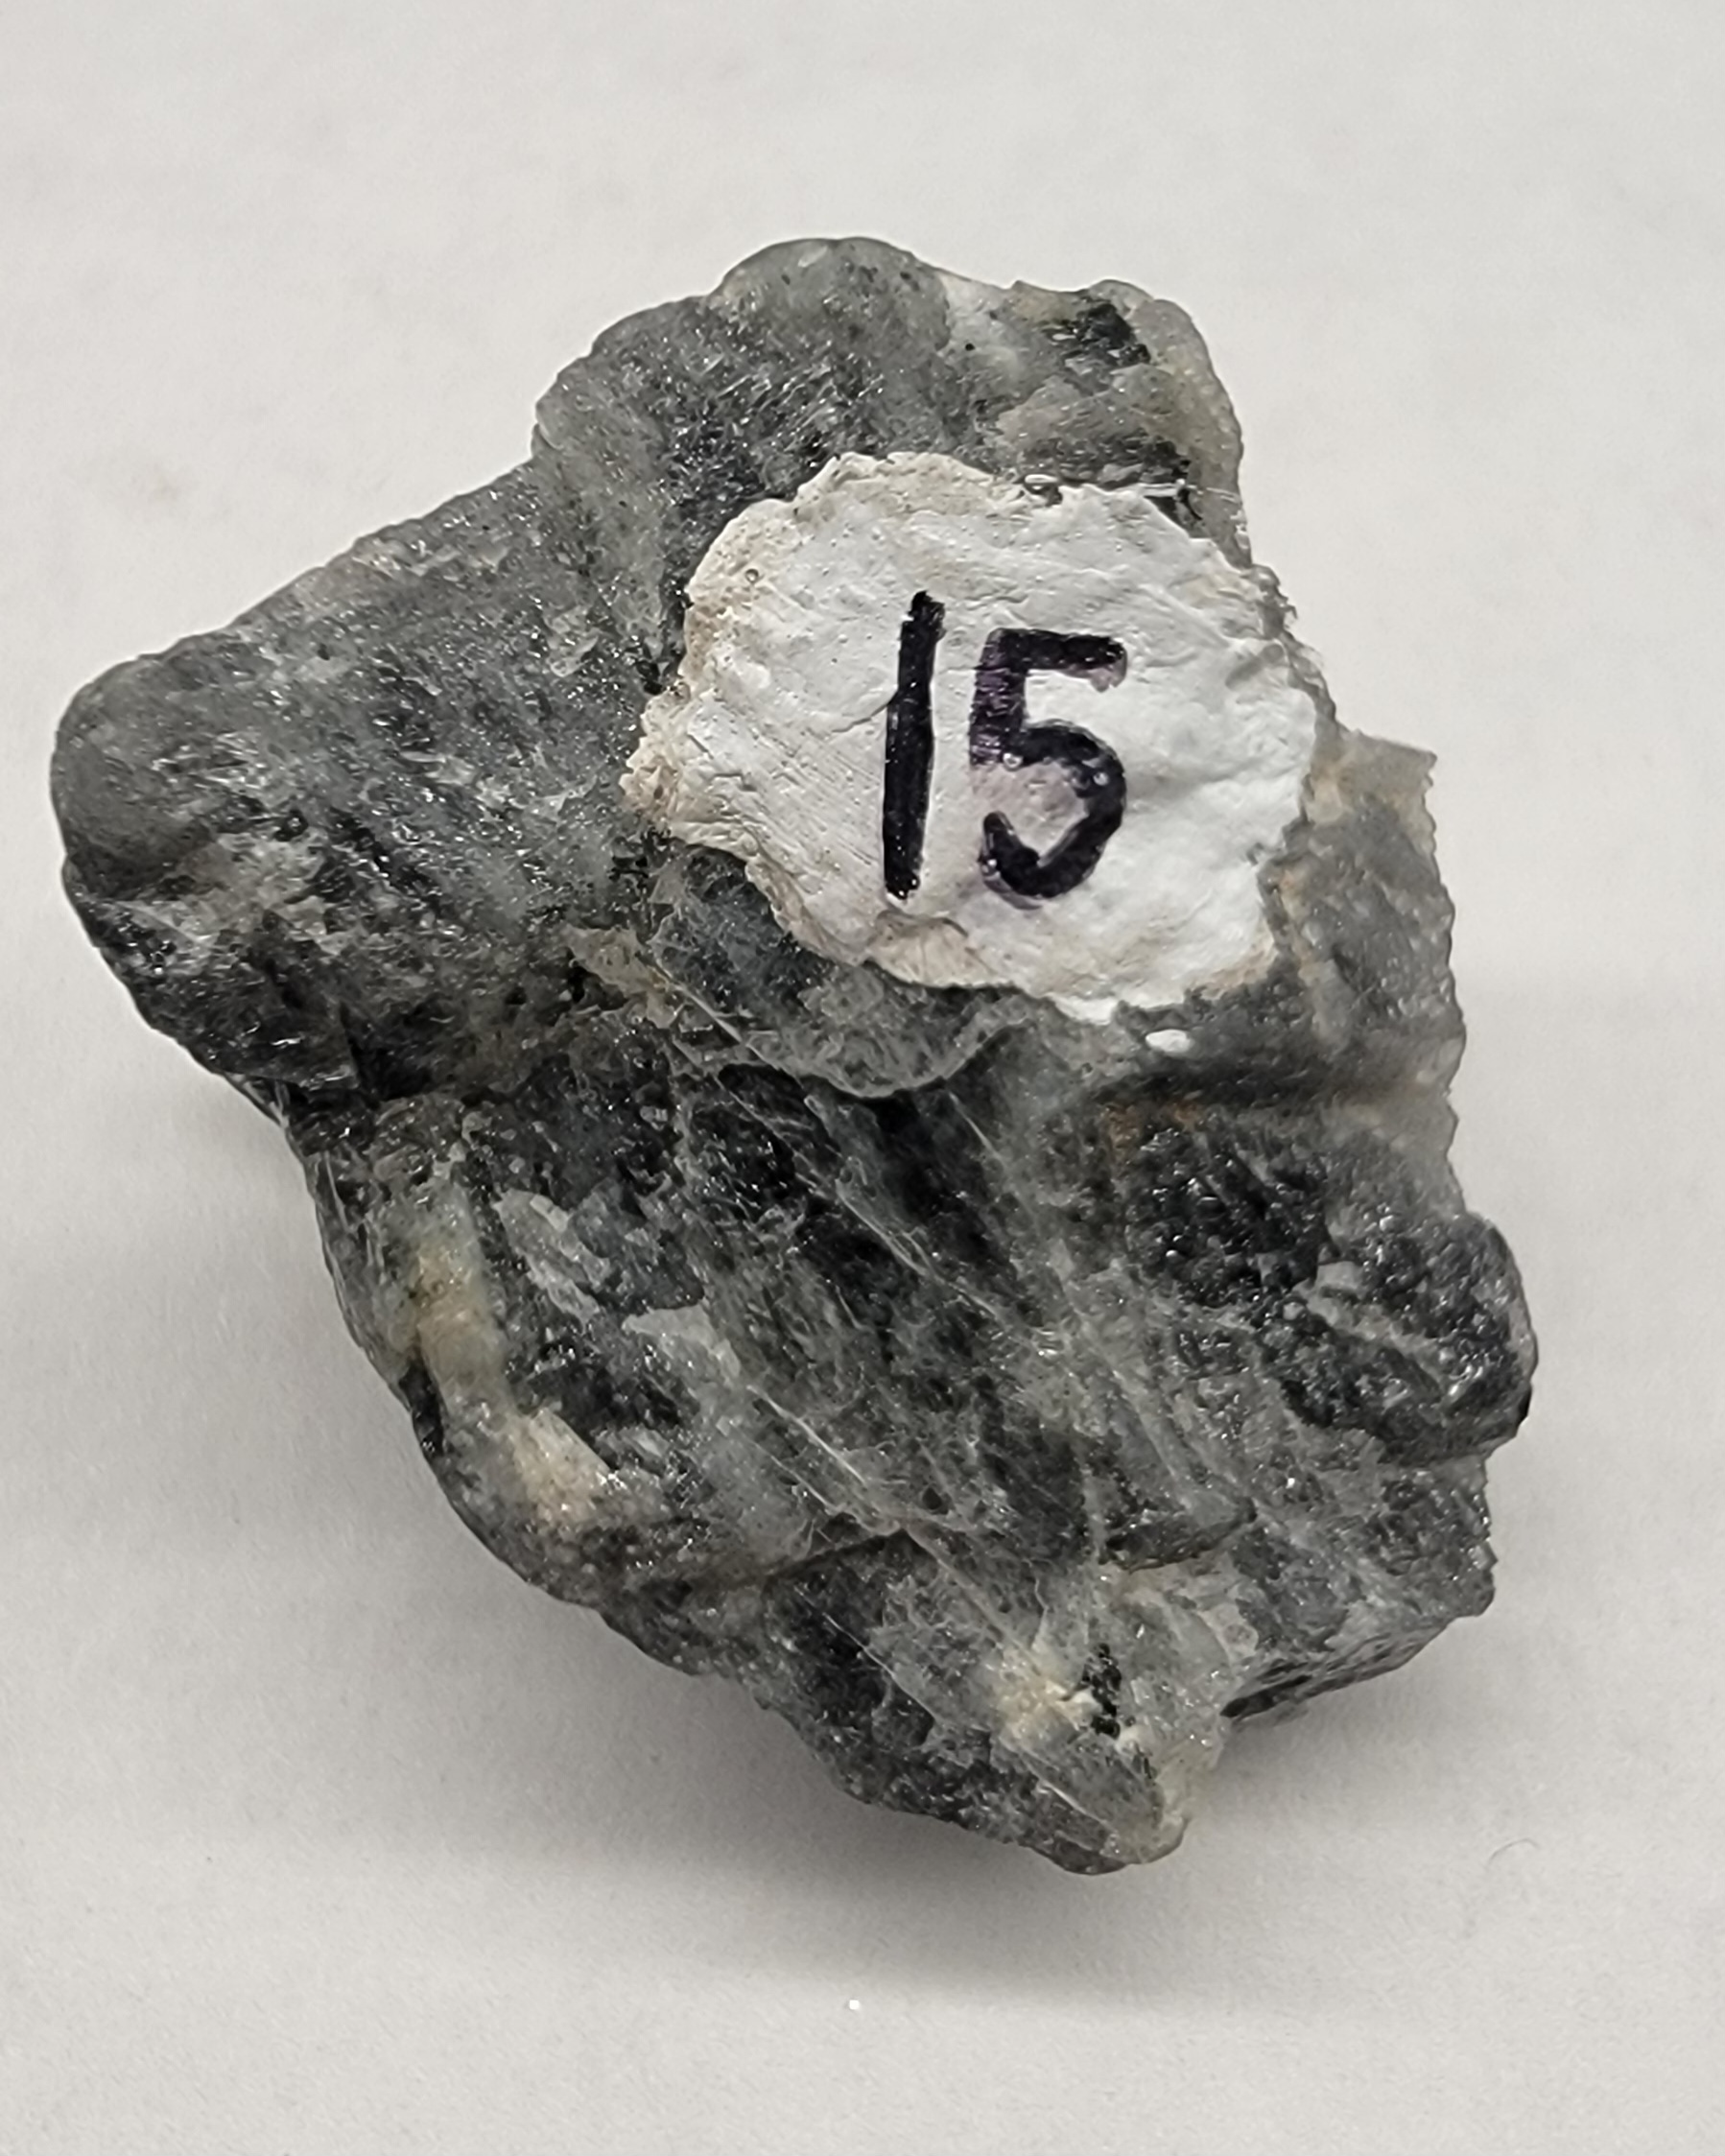
Sample 15
Plagioclase feldspar
Non-Metallic
2-directions cleavage
softer than nail
light or dark gray coloration
mafic, dark-colored, silicate mineral

