Slide 3
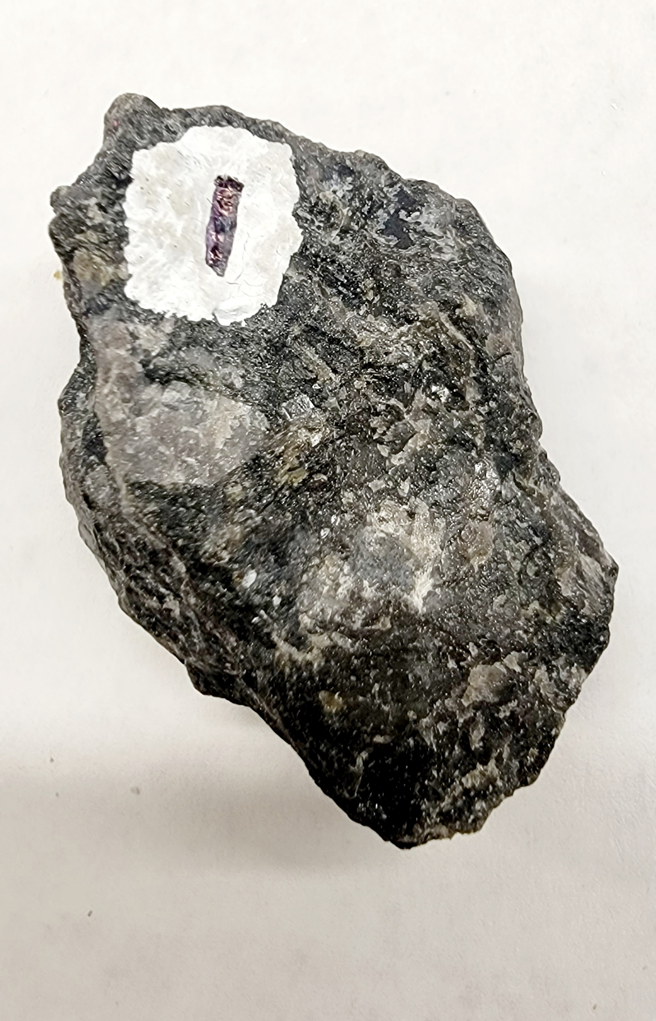
Sample 1
Gabbro
dark-colored, mafic
coarsely crystalline, phaneritic
minerals: dark plagioclase feldspar, amphibole, augite

Slide 4
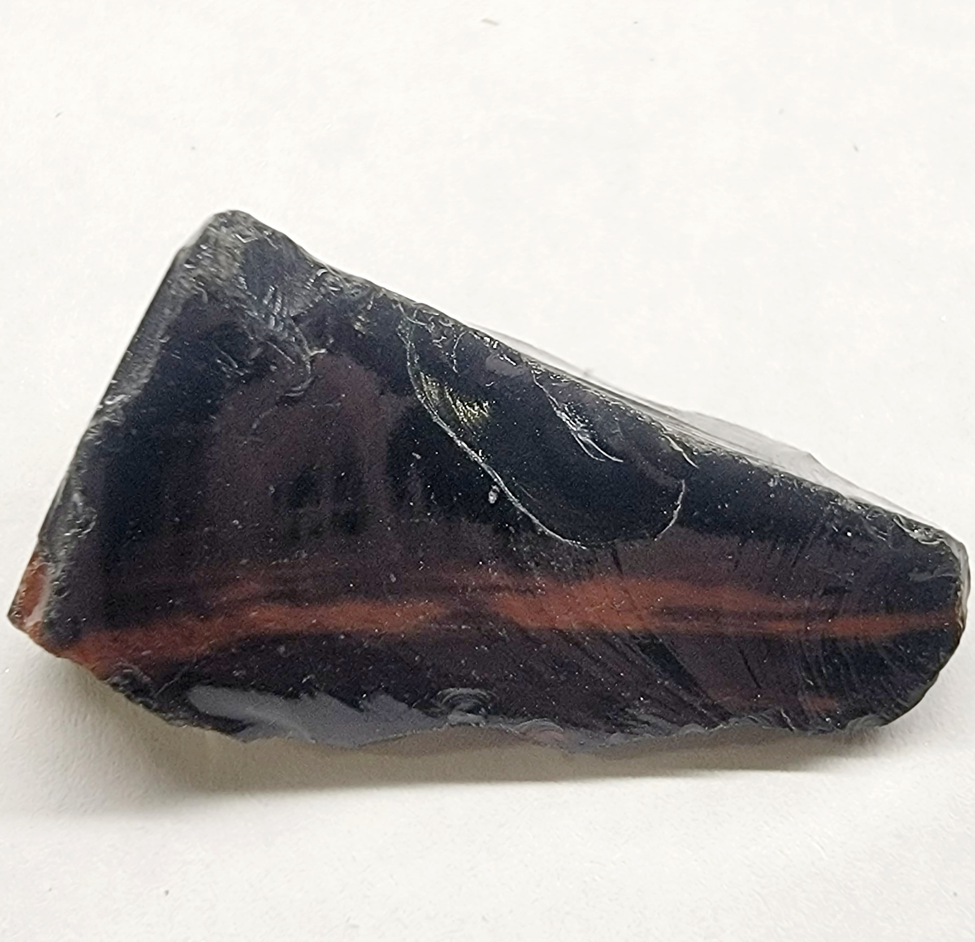
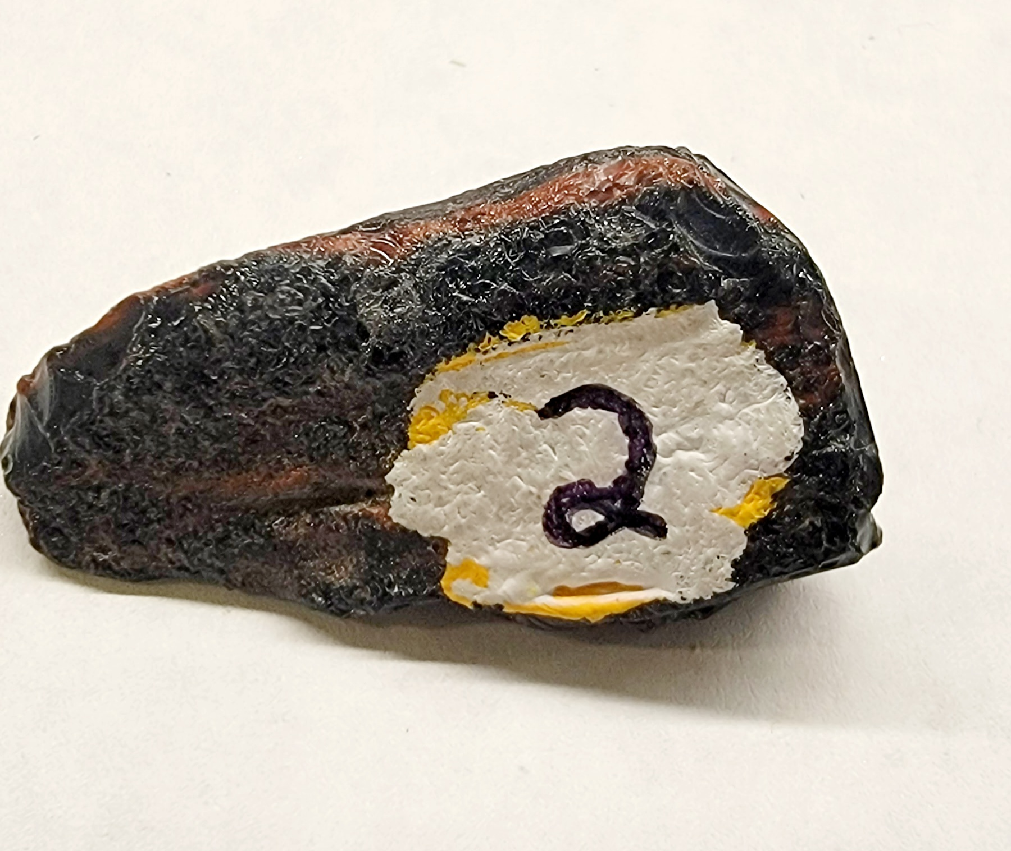
Sample 2
Obsidean (volcanic glass)
dark-colored due to elemental impurities
amorphous, glassy
minerals: N/A (glass)

Slide 5
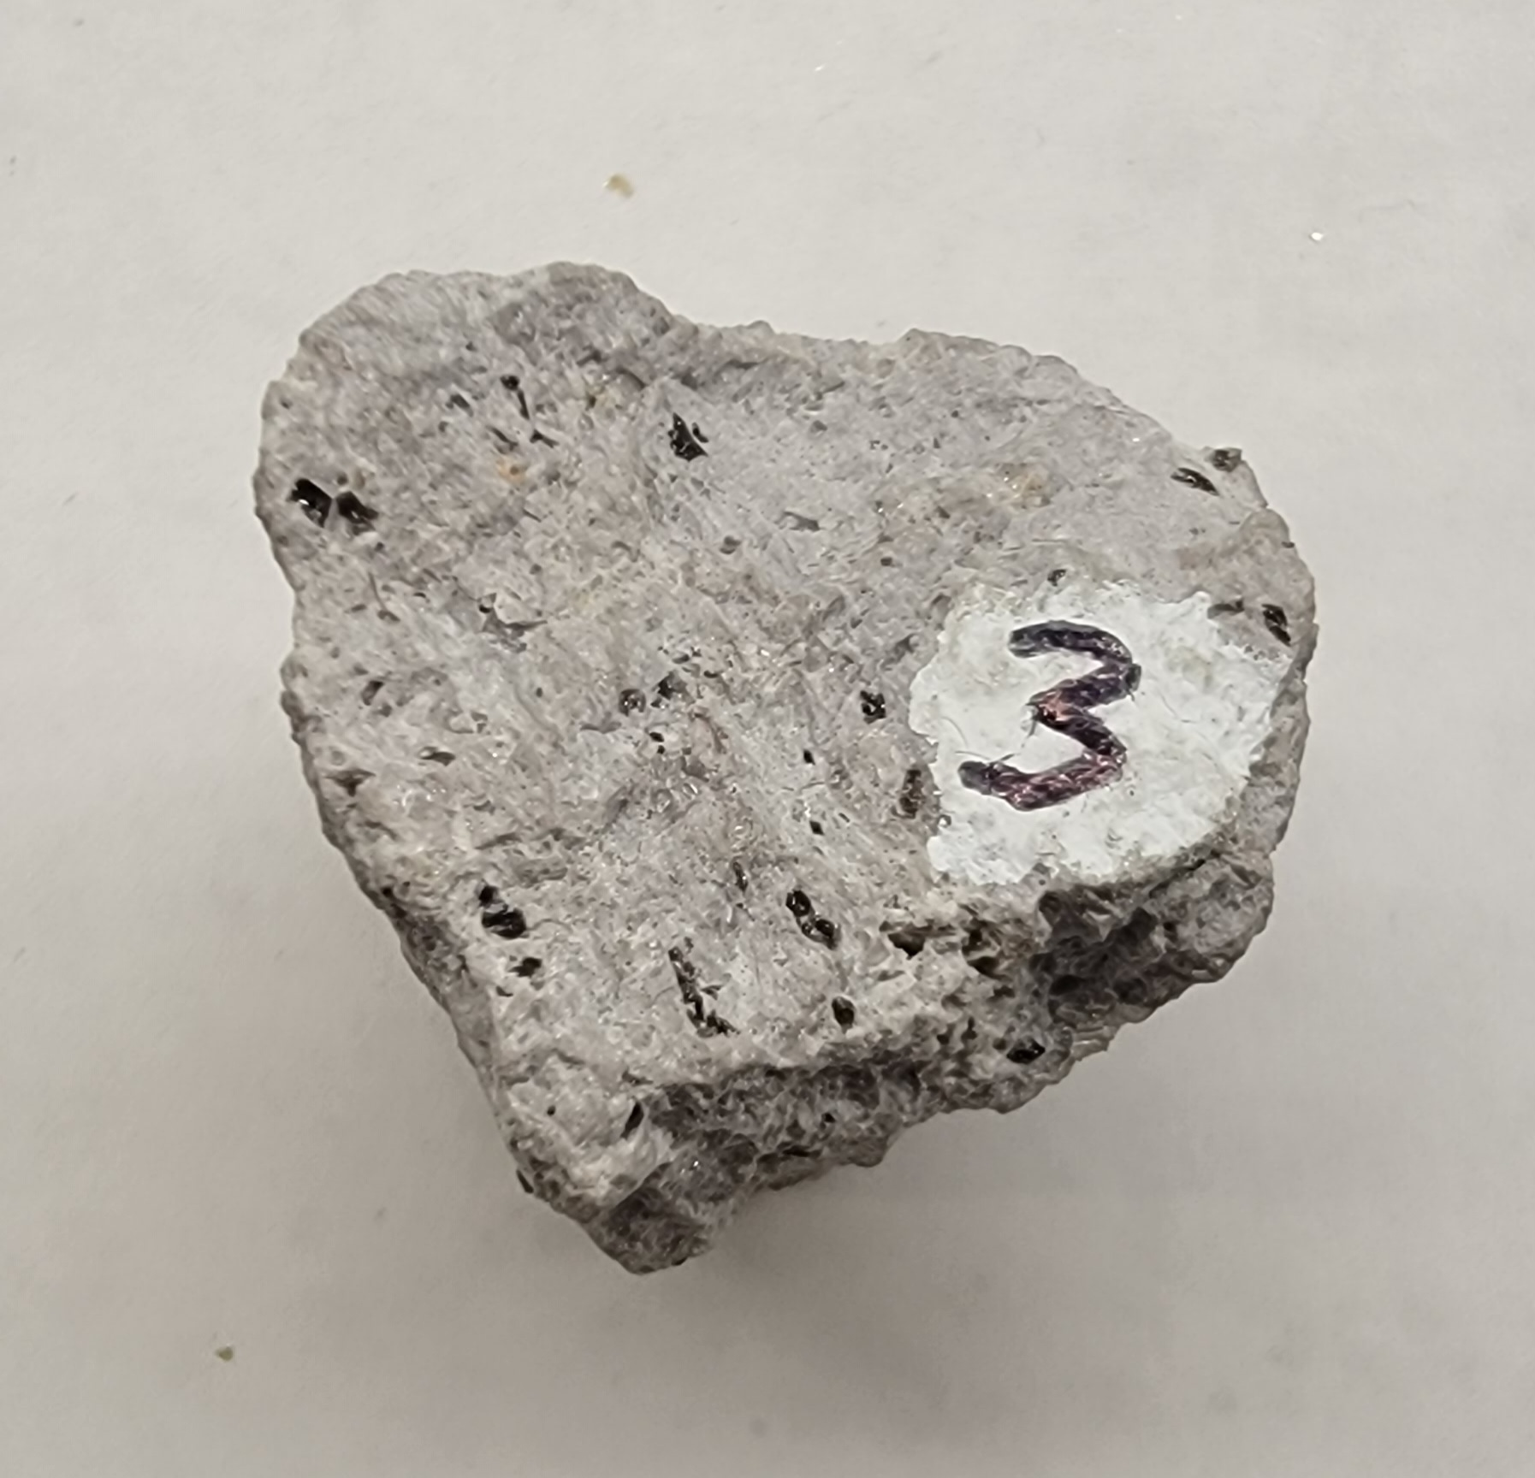
Sample 3
Rhyolite
light-colored, felsic
finely crystalline, aphanitic
minerals: mostly quartz, potassium feldspar, mica

Slide 6
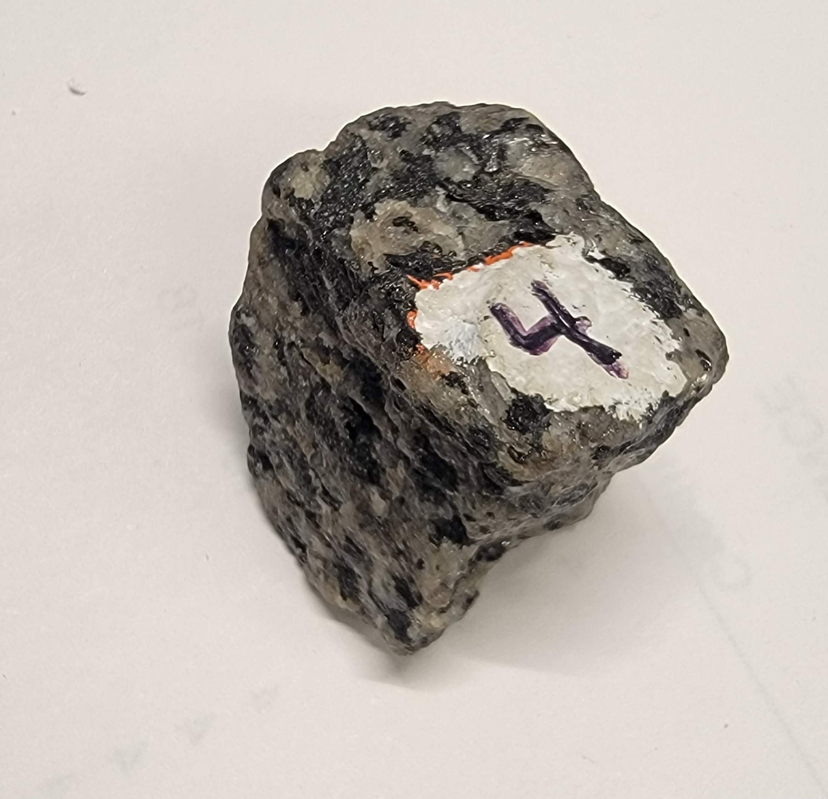
Sample 4
Diorite
salt-and-pepper, intermediate color mixc
coarsely crystalline, phaneritic
minerals: plagioclase feldspar, k-spar, no quartz amphibole

Slide 7
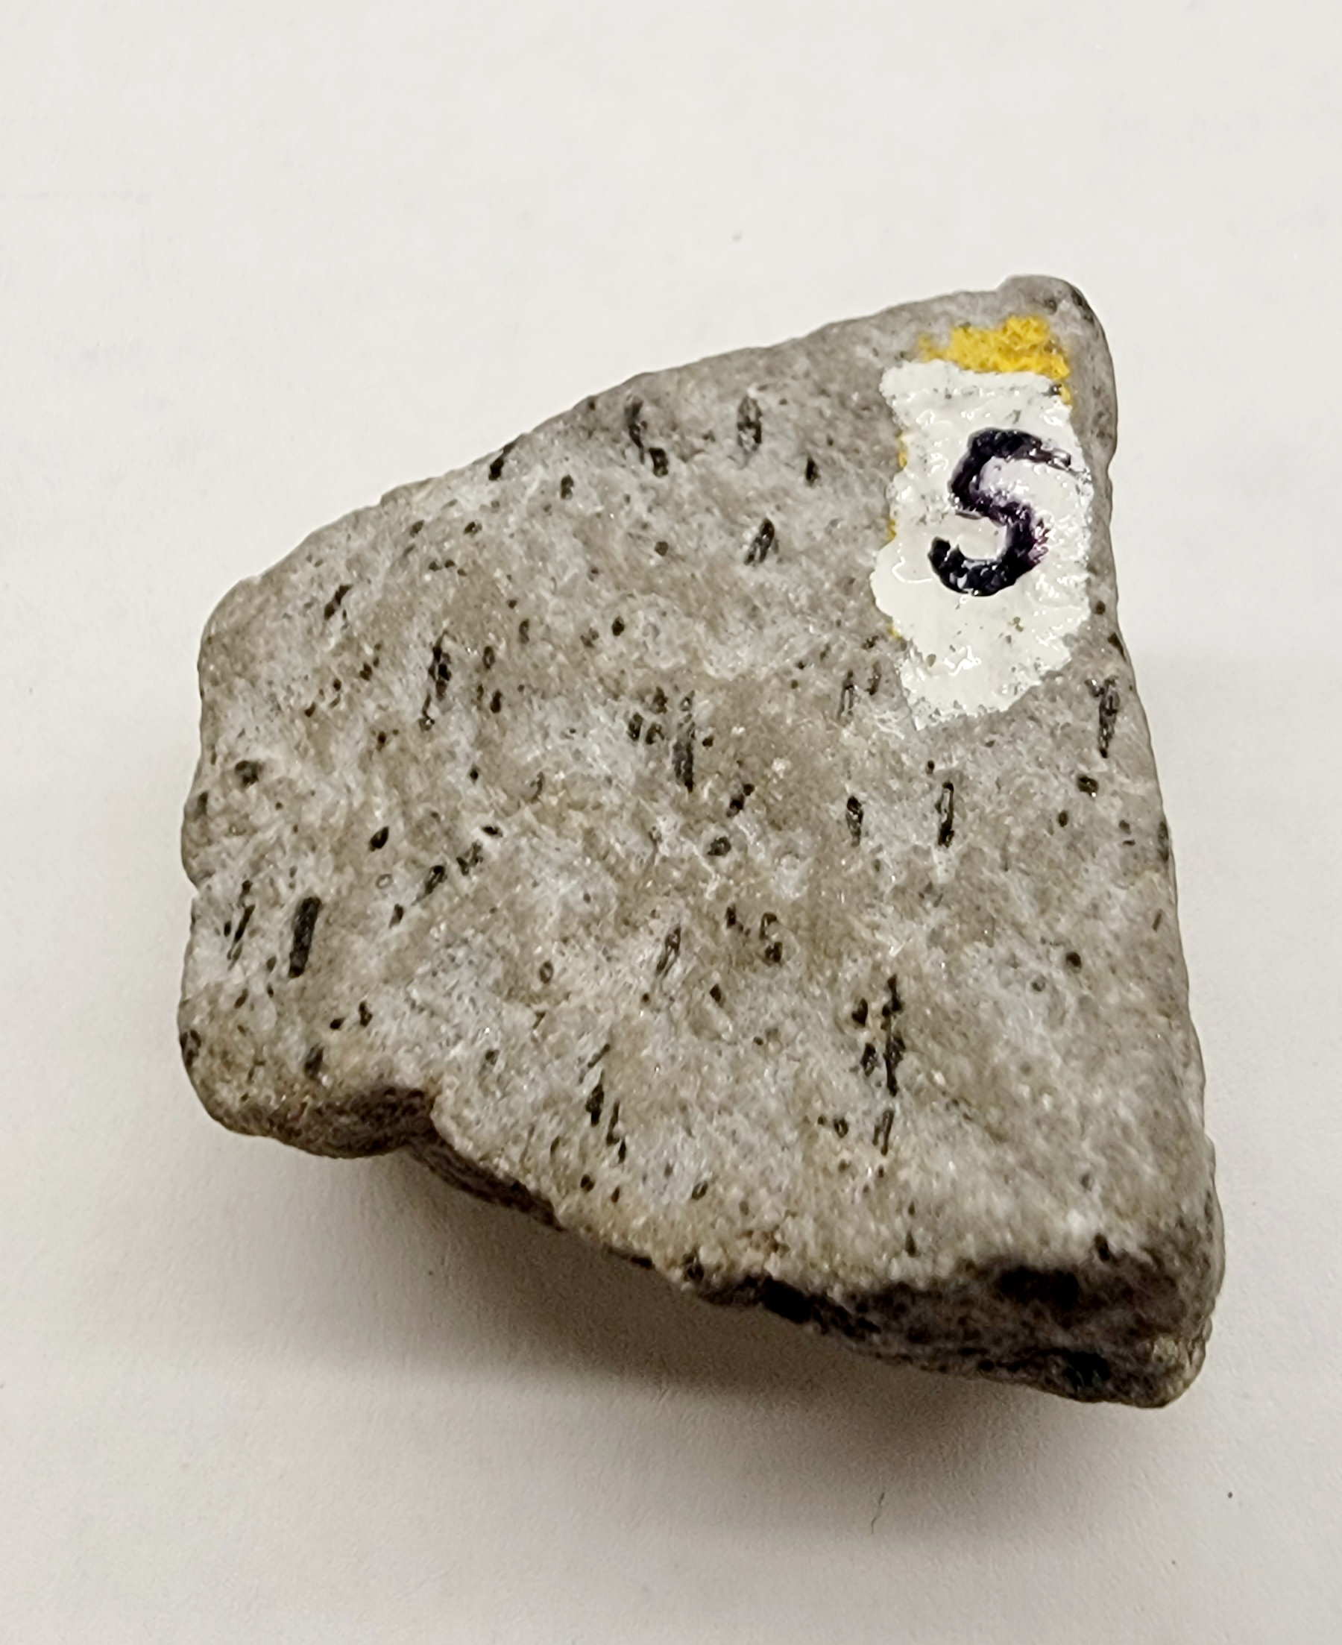
Sample 5
Andesite (porphyritic)
gray, intermediate color
finely crystalline with dark crystals (porphyritic)
minerals: plagioclase feldspar, amphibole

Slide 8
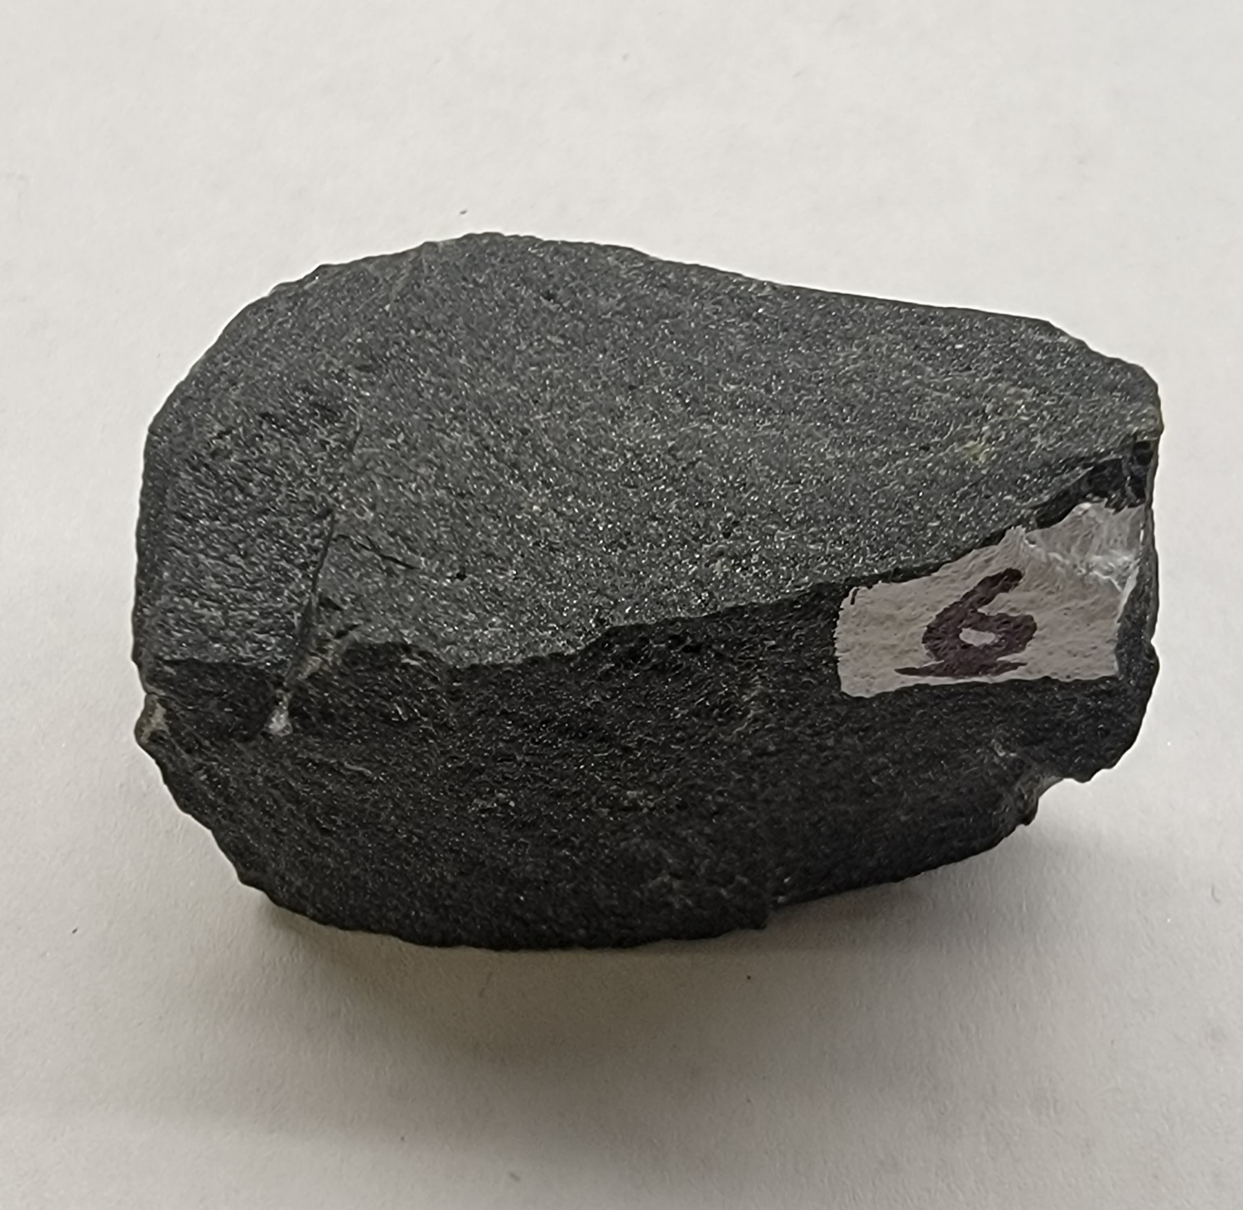
Sample 6
Basalt
dark-colored, mafic
finely crystalline, aphanitic
minerals: dark plagioclase feldspar, amphibole, augite

Slide 9
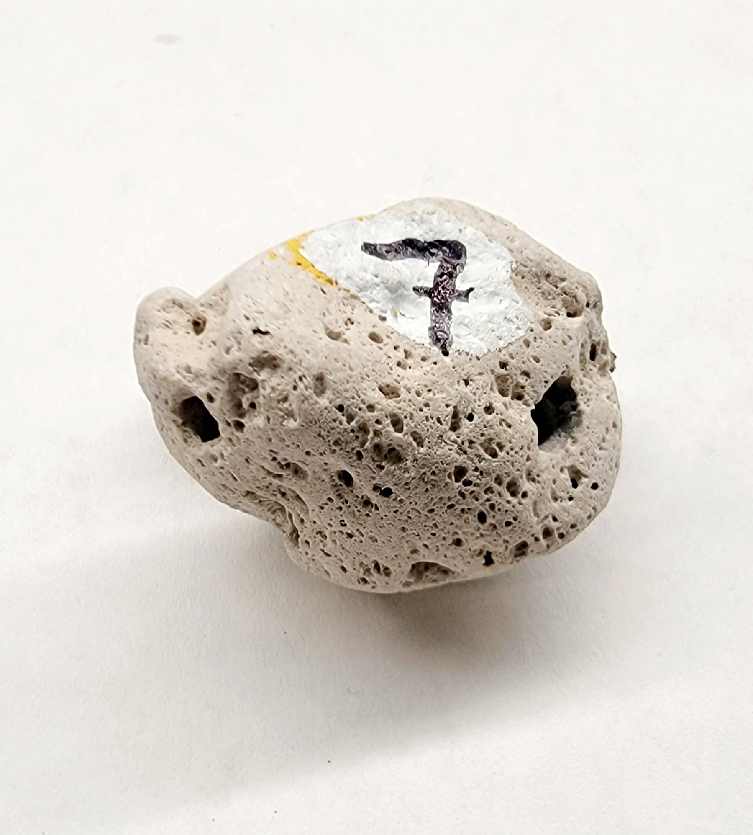
Sample 7
Pumice
light color, felsic
light weight, vesicles, frothy sponge like texture

Slide 10
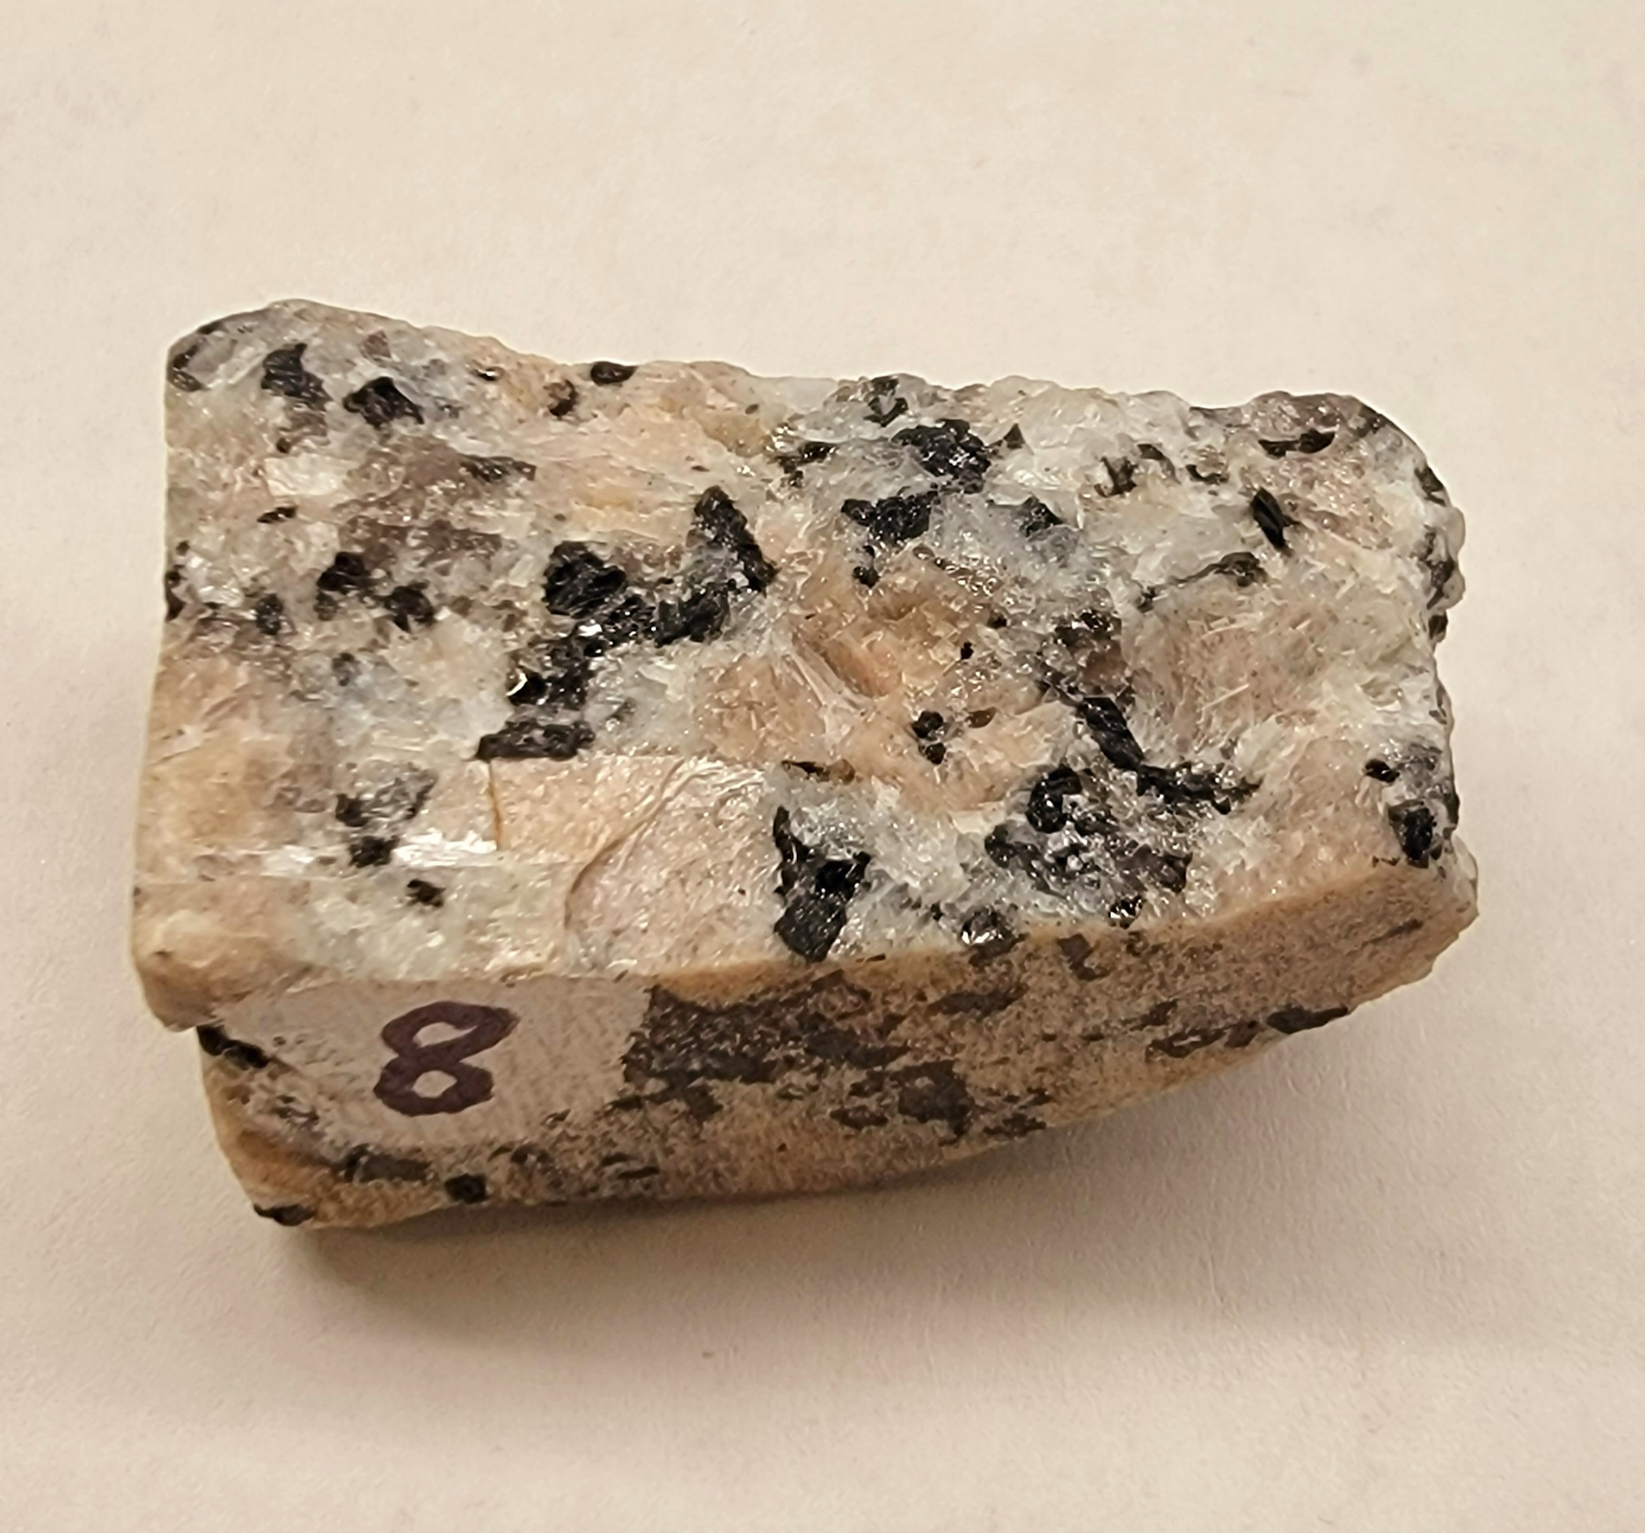
Sample 8
Granite
light-colored, felsic
coarsely crystalline, phaneritic
minerals: quartz, potassium feldspar, amphibole, biotite

Slide 11
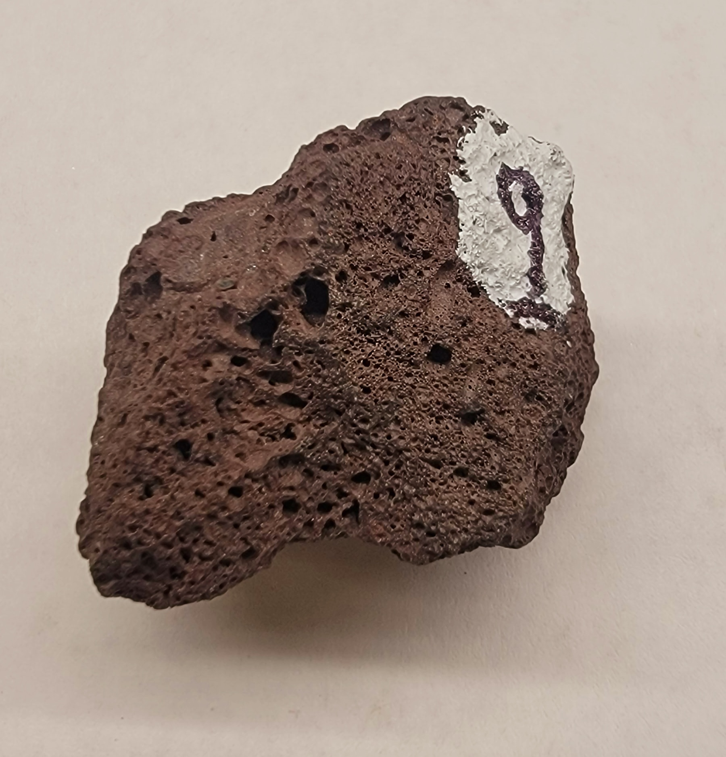
Sample 9
Scoria
dark color, mafic
light weight, vesicles, frothy sponge like texture

Slide 12
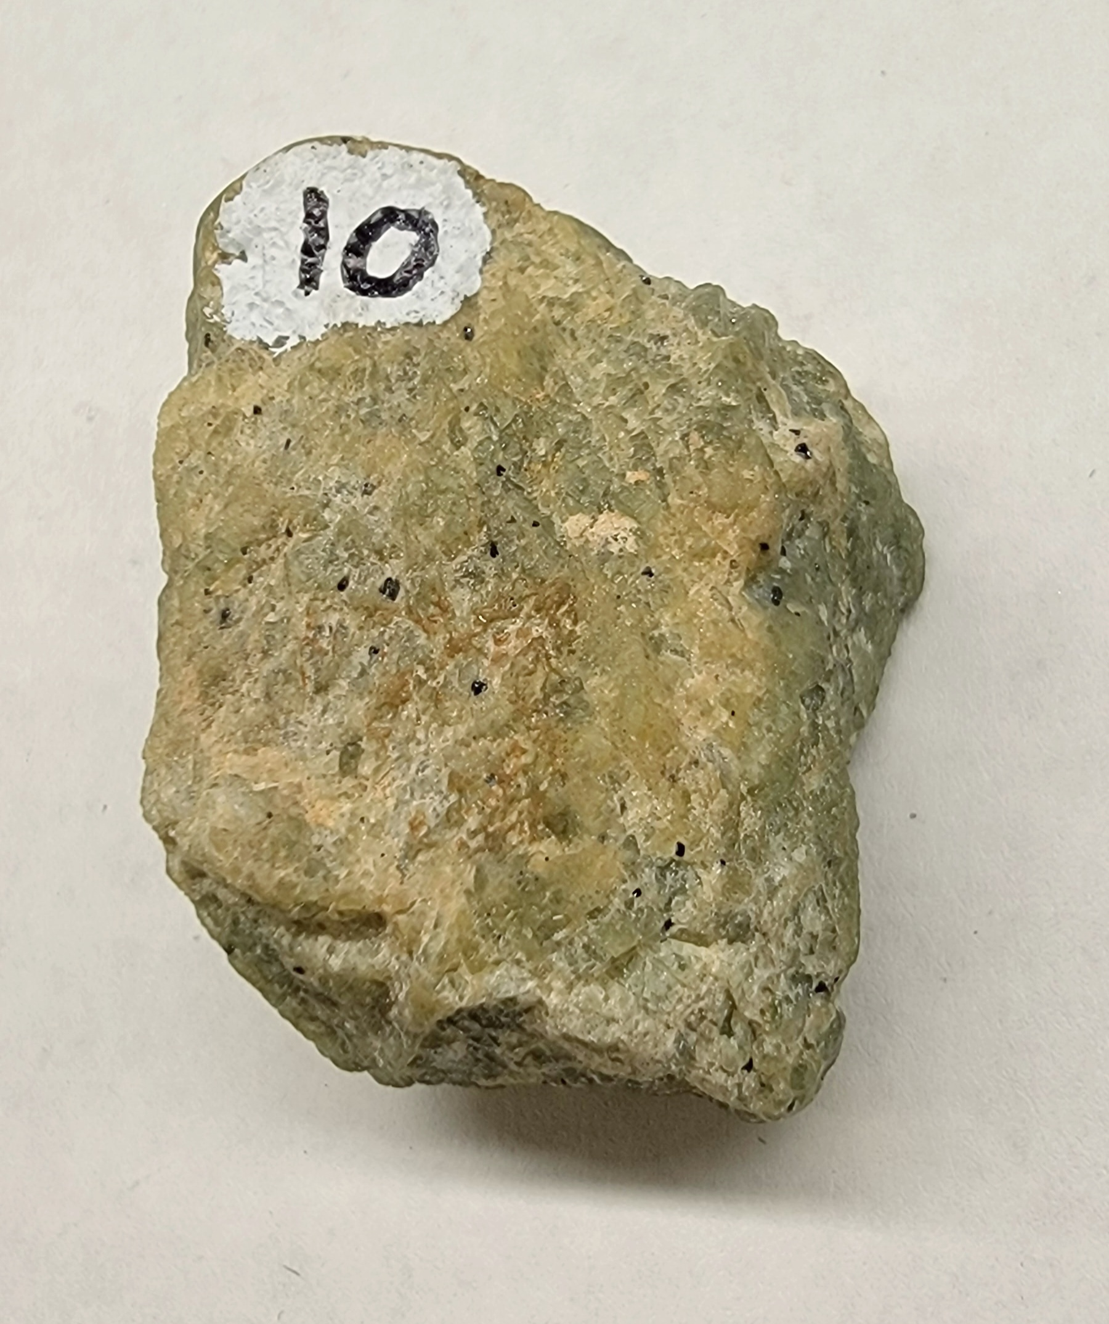
Sample 10
Peridotite (olivine-rich)
dark-colored, mafic
coarsely crystalline, phaneritic
minerals: olivine

